Slide 1
Marketing for absolute beginners
Justine Aldous
Marketing Communications Manager
justinea@surreyca.org.uk
Notes:
Introduction
Quick whistle stop tour around some marketing basics
This is a workshop so will be some work!

Slide 2
No silver bullet!
If at first you don’t succeed, then try, try and try again!
Macmillan - DOUBLED their voluntary income since investing in communications...
BUT it’s taken ten years…
Notes:
WORKSHEET
Guess the date of the extract
Thomas Smith’s Guide to Successful Advertising written in 1885

Slide 3
Marketing basics
What you need to know

Slide 4
Identify your audiences
Define your target audience so that you can tailor your communications accordingly
Supporters?
Beneficiaries/clients?
Partners?
Funders?
Local MP?
Volunteers?
Notes:
People think WHAT they want to communicate before they think about WHO they want to communicate to.
Need different approaches for different audiences – social media for young people/letter to a councillor/newsletter to volunteers
WORKSHEET – identify your audiences

Slide 5
Find the right tone of voice
Are you a youth charity?
youthful, energetic and quirky
Are you a health charity?
Informative yet approachable and caring
BUT
may need to adjust tone to suit audience
Notes:
Brand’s personality expressed through colours/fonts/graphics/sonic mnemonics
BUT also expressed through the words it chooses
Find voice, stick with it but adjust to suit audience (lobbying your MP v inviting young people to an event)
WORKSHEET – identify the right tone of voice for your organisation

Slide 6
Create an effective campaign message
Problem – how does it affect your audience?
1
Solution – what difference can your organisation make?
2
Call to action! Ask your audience to do something specific
3
Notes:
Different ways to create an effective message.
Simple, tried and tested formula

Slide 7
Problem
Solution
Call to action
Notes:
WORKSHEET – create a message using this formula

Slide 8
Problem
Solution
Call to action
Notes:
WORKSHEET – create a message using this formula

Slide 9
Problem
Solution
Call to action
Notes:
WORKSHEET – create a message using this formula

Slide 10
Communication tools
PR
Advertising
Blogs and (e)newsletters
Social media
Events
Marketing materials
Website
Champions and ambassadors/patrons
Notes:
PR – Free publicity BUT must be well-targeted so use a hook. Lot of demand = limited opportunities. No control over message
Advertising – expensive BUT guaranteed coverage. Can control the message
Blogs and enewsletters – Free but limited audience (website visitors or your database). Can control the message
Social media – Free BUT takes a long time to build momentum. Needs constant feeding.
Marketing materials – leaflets, posters, printed newsletters.
Website – can be expensive to create a custom built site BUT there are alternatives
Champions and ambassadors – Free but need to nurture. Can’t always control the message!

Slide 11
News releases
Research local titles
Newspapers/syndicated magazines/church news
Identify your hook
Milestone/topical event/market research
Include the five ‘W’s
Who
What
Where
When
Why
Don’t forget to KISS!
Notes:
Research local titles: local or paid for local newspaper/parish or church newsletter/magazine from a residents’ association/syndicated publication – Guide 2 series/Round and About/Vantage Point
Local radio stations
Online news websites – Guildford Dragon
Local school newsletters
Ask friends, colleagues, neighbours to collect titles for you to create media database
IDENTIFY YOUR HOOK
May be milestone = 25th anniversary/1000th volunteer
Relevant to topical news story – benefit cap = increased uptake of services
Survey – 75% of our volunteers drivers finding hospital parking spaces hard to find
5 W’s
News editors cut from the top down
Try and include as much key information in opening para (your 5 w’s) and use rest of news release to expand upon those
WORKSHEET
KISS! Unless the entire royal family coming to help out at your charity for the day…Keep it short and simple and maximum of one side

Slide 12
Websites
Your online shop window - post news, make an appeal, promote events, share success. You have control of your message.
Dedicated url – www.wokinggoodneighbours.org.uk
Community sites – www.interests.me www.surreycommunity.info
Notes:
Websites are your online ‘shop window’. The internet is now a business fact of life - it’s where the vast majority of people turn when they are looking for information.
Ideally own custom built website with dedicated URL (personalised website address)
No resources? Several community websites which allow you to create mini-websites with theirs, free of charge
www.interests.me allows you to have a community webpage and create and share enewsletters with your own groups and others within your local area so you can spread your news more widely.
www.surreycommunity.info is a website developed by the county council and the 11 district and borough councils.

Slide 13
Leaflets
Catch attention with great design
Try www.canva.com
Clear message – KISS!
Call to action
The right size
Proof it!
Distribution
Notes:
Need a catchy headline or unusual colours, to catch the attention of the recipient. If you are dropping your leaflets through the letterbox, chances are the person receives a few leaflets every day. Your leaflet must therefore have something to immediately draw the person’s attention and make them read the whole thing.
If you cannot afford to use a graphic designer then you can try free online design tools such as www.canva.com. You don’t need to download any software or use any particular type of computer.
Like the old saying about a falling tree making no noise if there’s no one in the forest to hear it, a great leaflet poorly distributed isn’t worth a penny.

Slide 14
Champions
Don’t overlook the obvious
1
Volunteers
Staff
Give a little nudge now and then!
2
Beneficiaries
Notes:
Volunteers/staff are your best ambassadors - most effective communication tools you have. Who else can speak so passionately about the benefits of volunteering for your scheme?
BUT sometimes people forget to talk about something when it becomes a way of life - so give a gentle reminder every now and then to encourage your volunteers to talk to friends, family, colleagues and neighbours.
WORKSHEET – identify some champions = key people that support your organisation

Slide 15
Social media
Be part of the revolution!
Notes:
Did you know that if the Facebook community was a population it would be the largest in the world?
Or that more people own a mobile device than own a toothbrush?
Or that grandparents are the fastest growing demographic on Twitter?
Love it or loathe it, social media is here to stay. It’s growing and it’s growing fast so it’s time to jump on board – especially as Facebook is now also the second most used search engine (after Google).
Social media can be one of the most effective ways for charities and community organisations to build supporters, boost donations, share success stories, network with like-minded organisations, encourage people to sign up to campaigns, recruit volunteers, or demonstrate the impact of their work.
Posts on Twitter are limited to just 140 characters (including spaces) so writing an erudite tweet can take a little practice at first. Its users are primarily businesses and those interested in news and celebrities.
Facebook has more of a personal and community audience so is better suited to organisations like good neighbour schemes. There’s no limit to the number of words or pictures you can post (although the KISS rule still applies).
Creating a Facebook or Twitter account is free and take just a few minutes to set up. Encourage your volunteers to like and share your posts – these recommendations are super-targeted (going to like minded people), personal and FREE!

Slide 16
Which sites?
There are hundreds of social media sites – which ones are right for you?
Facebook? Twitter? NING? Tagged? Badoo? New sites emerging every day.
Despite the headlines, Facebook and Twitter continue to dominate
Notes:
Don’t spread yourself too thinly. There’s a lot of noise on social media so need to work hard to make yourself heard

Slide 17
Why use it?
Social media can be one of the most effective ways to:
Build a supporter base
Boost donations
Share success stories
Connect with like-minded organisations
Encourage people to sign up to campaigns or events
Recruit volunteers or staff
Demonstrate your impact
Notes:
Social media is a conversation. No-one likes to be talked AT incessantly.

Slide 18
Get started!
The communication principles remain the same:
Identify your target audience (like/follow them)
Think about your message (problem/solution/call to action)
Be consistent with your brand (logo, tone of voice etc)
BUT remember it’s a conversation!
Share information (retweets and shares)
Start a dialogue (questions, facts, contests, polls)
Notes:
Social media is a conversation. No-one likes to be talked AT incessantly.

Slide 19
Facebook and Twitter basics
Twitter posts are limited – 280 characters
Twitter users = organisations/businesses
Facebook unlimited text and images (but KISS!)
Facebook users = individuals & community
Both are free and easy to set up
Use images and video to attract views.
Try lumen5.com for easy videos
Encourage your volunteers/staff/supporters to share posts
Notes:
Social media is a conversation. No-one likes to be talked AT incessantly.

Slide 20
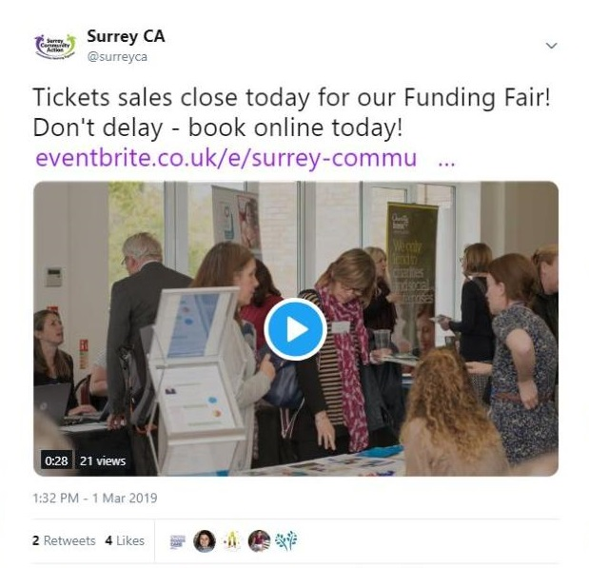
Notes:
WORKSHEET

Slide 21
Any questions?
Follow us:
Twitter - @SurreyCA
Facebook – surreycommunityaction
www.surreyca.org.uk

