Slide 1
VCFS Cost of Living Workshop

Slide 2
Some Context
Context
New economic pressures not felt for decades
Healthy VCFS needed
Covid Legacy
More demand
More complexity
Situation evolving rapidly
Rate of CoL increase is slowing, but still rising
Sector coping well on average
Many struggling through no fault of their own
Small community groups (fewer overheads, no staff costs) better placed to weather the storm
Larger organisations (employing staff, greater overheads) facing greater challenges

Slide 3
Recruitment and Retention – Staff and Volunteers
Recruitment of staff increasingly difficult and salary driven.
Part time/full time balance shifting
More staff moving for money
More volunteers having to work
Salaries having to increase (2-10%)
One-off Cost of Living payments
Non-cash benefits eg training being looked at

Slide 4
Rising Costs for Good and Services
Energy costs continue to rise
Other costs continue to rise
Maintenance costs rising and harder to find contractors
Harder to carry out capital projects
Some are passing on costs to service users
Some are accelerating move to energy efficiency measures, including renewables
Some are training staff to carry out functions previously outsourced

Slide 5
The Impact
Service reductions and cancellations
Passing on costs to service users
Increase in demand for services, more complex needs and more people needing help for the first time

Slide 6
The Response So Far
Spending reserves
Additional fundraising
Renegotiating
Implementing fees
Cost cutting

Slide 7
The Future
Most are expecting it to get worse
Most expect to shrink but survive

Slide 8
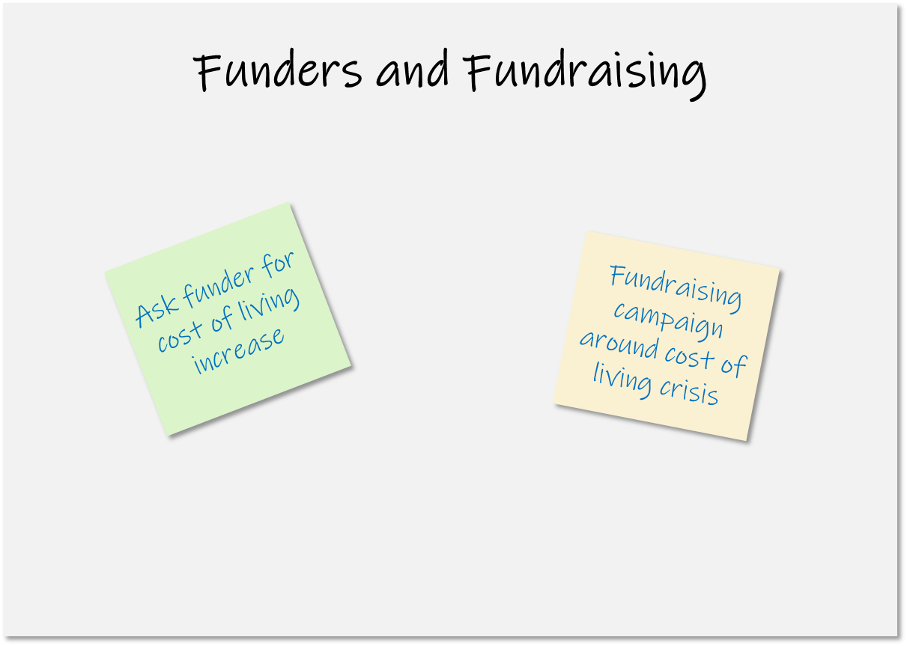
What Can We Do About It?
There are flipcharts with headings around the room
In pairs or small groups, consider what we can do to address the cost-of-living challenges on the flipcharts?
What have you done?
What have others done?
Jot it down on a post-it note
Stick it to the flipchart

Slide 9
What Can We Do About It?
I will take photos of all the flipcharts and send them to you all

Slide 10
Some Calls to Action
VCFS
Risk management
Seek in-kind support
Economies of scale
Salary and non-salary benefits review
Approach funders with evidence
FCR model
Shout!
Funders
Automatic COL increase
Redefine outputs
Offer in-kind support
Ensure recipients have robust FCR with inflationary increments
Recognise that pressure is unevenly spread
Voters
Lobby your MP

