Slide 1
Surrey Coalition of Disabled People
Nikki Roberts – CEO
Yasmin Broome – Involvement Lead
Notes:
Good afternoon everybody. Thank you so much for asking us to speak today about some of the work we’re undertaking in Surrey to support the Disabled and long term health condition community.
I think we’re quite unique in the work that we do, however, we do know of a few similar organisations across the country providing similar support.

Slide 2
What we do
We enable and empower Disabled people and those living with a long-term health condition to be an active and central part of the community.
We proactively work with health, social care and community partners to co-produce services, strategies and policy.
We campaign for choice and control to achieve our legal rights and entitlements. We identify and respond to gaps in support to meet the needs of Disabled people. We spotlight, celebrate and champion equity, diversity and inclusion.

Slide 3
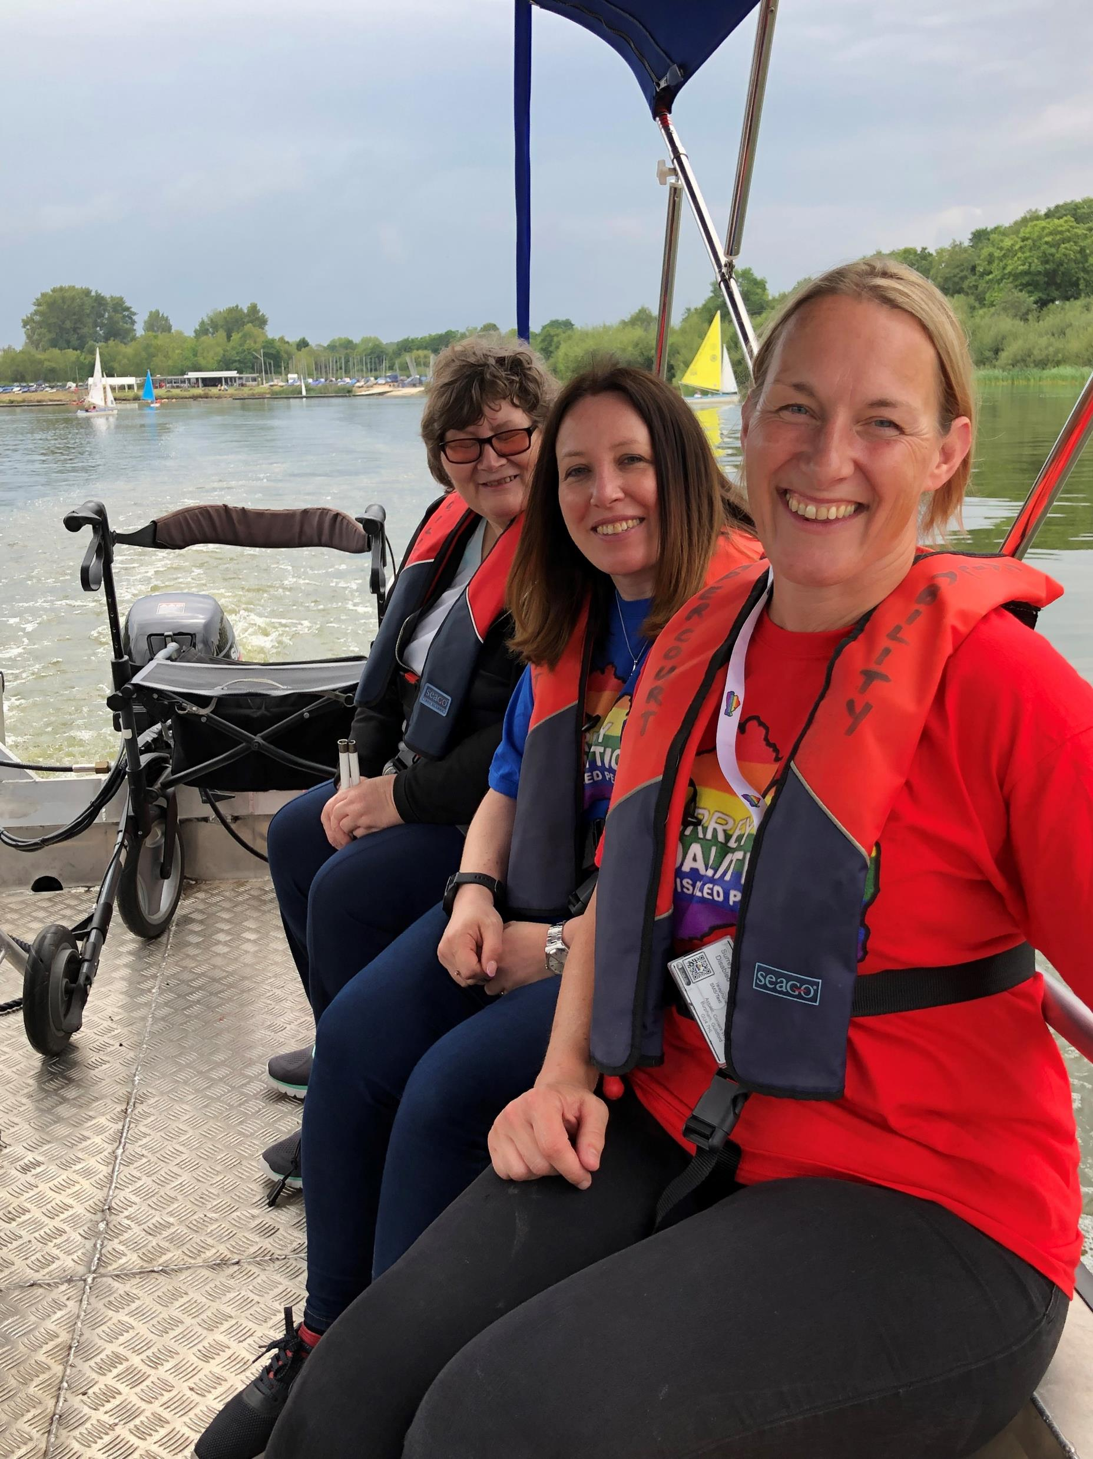
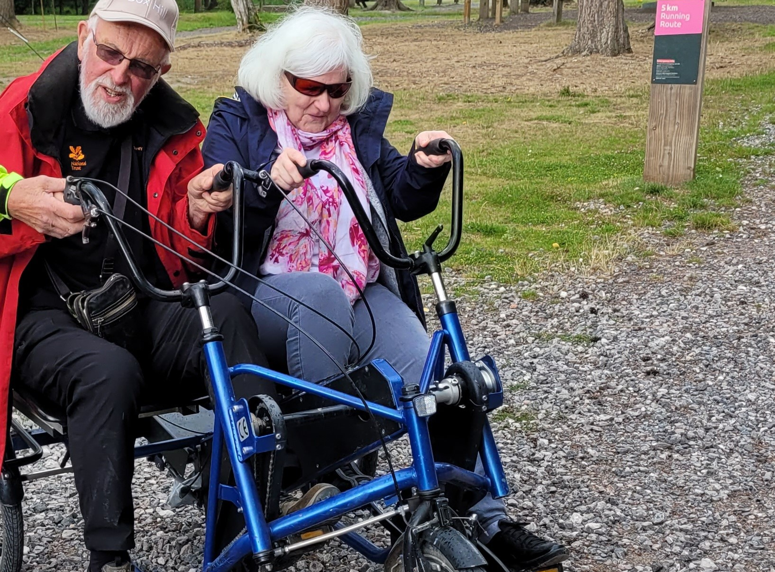
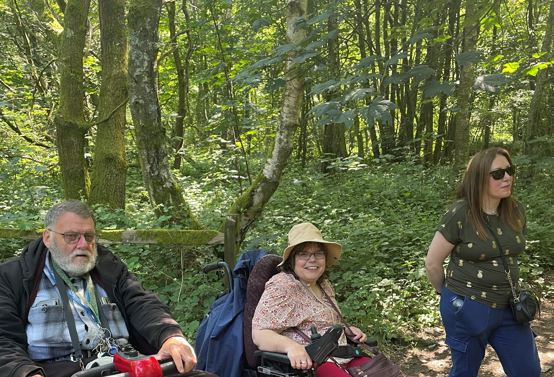
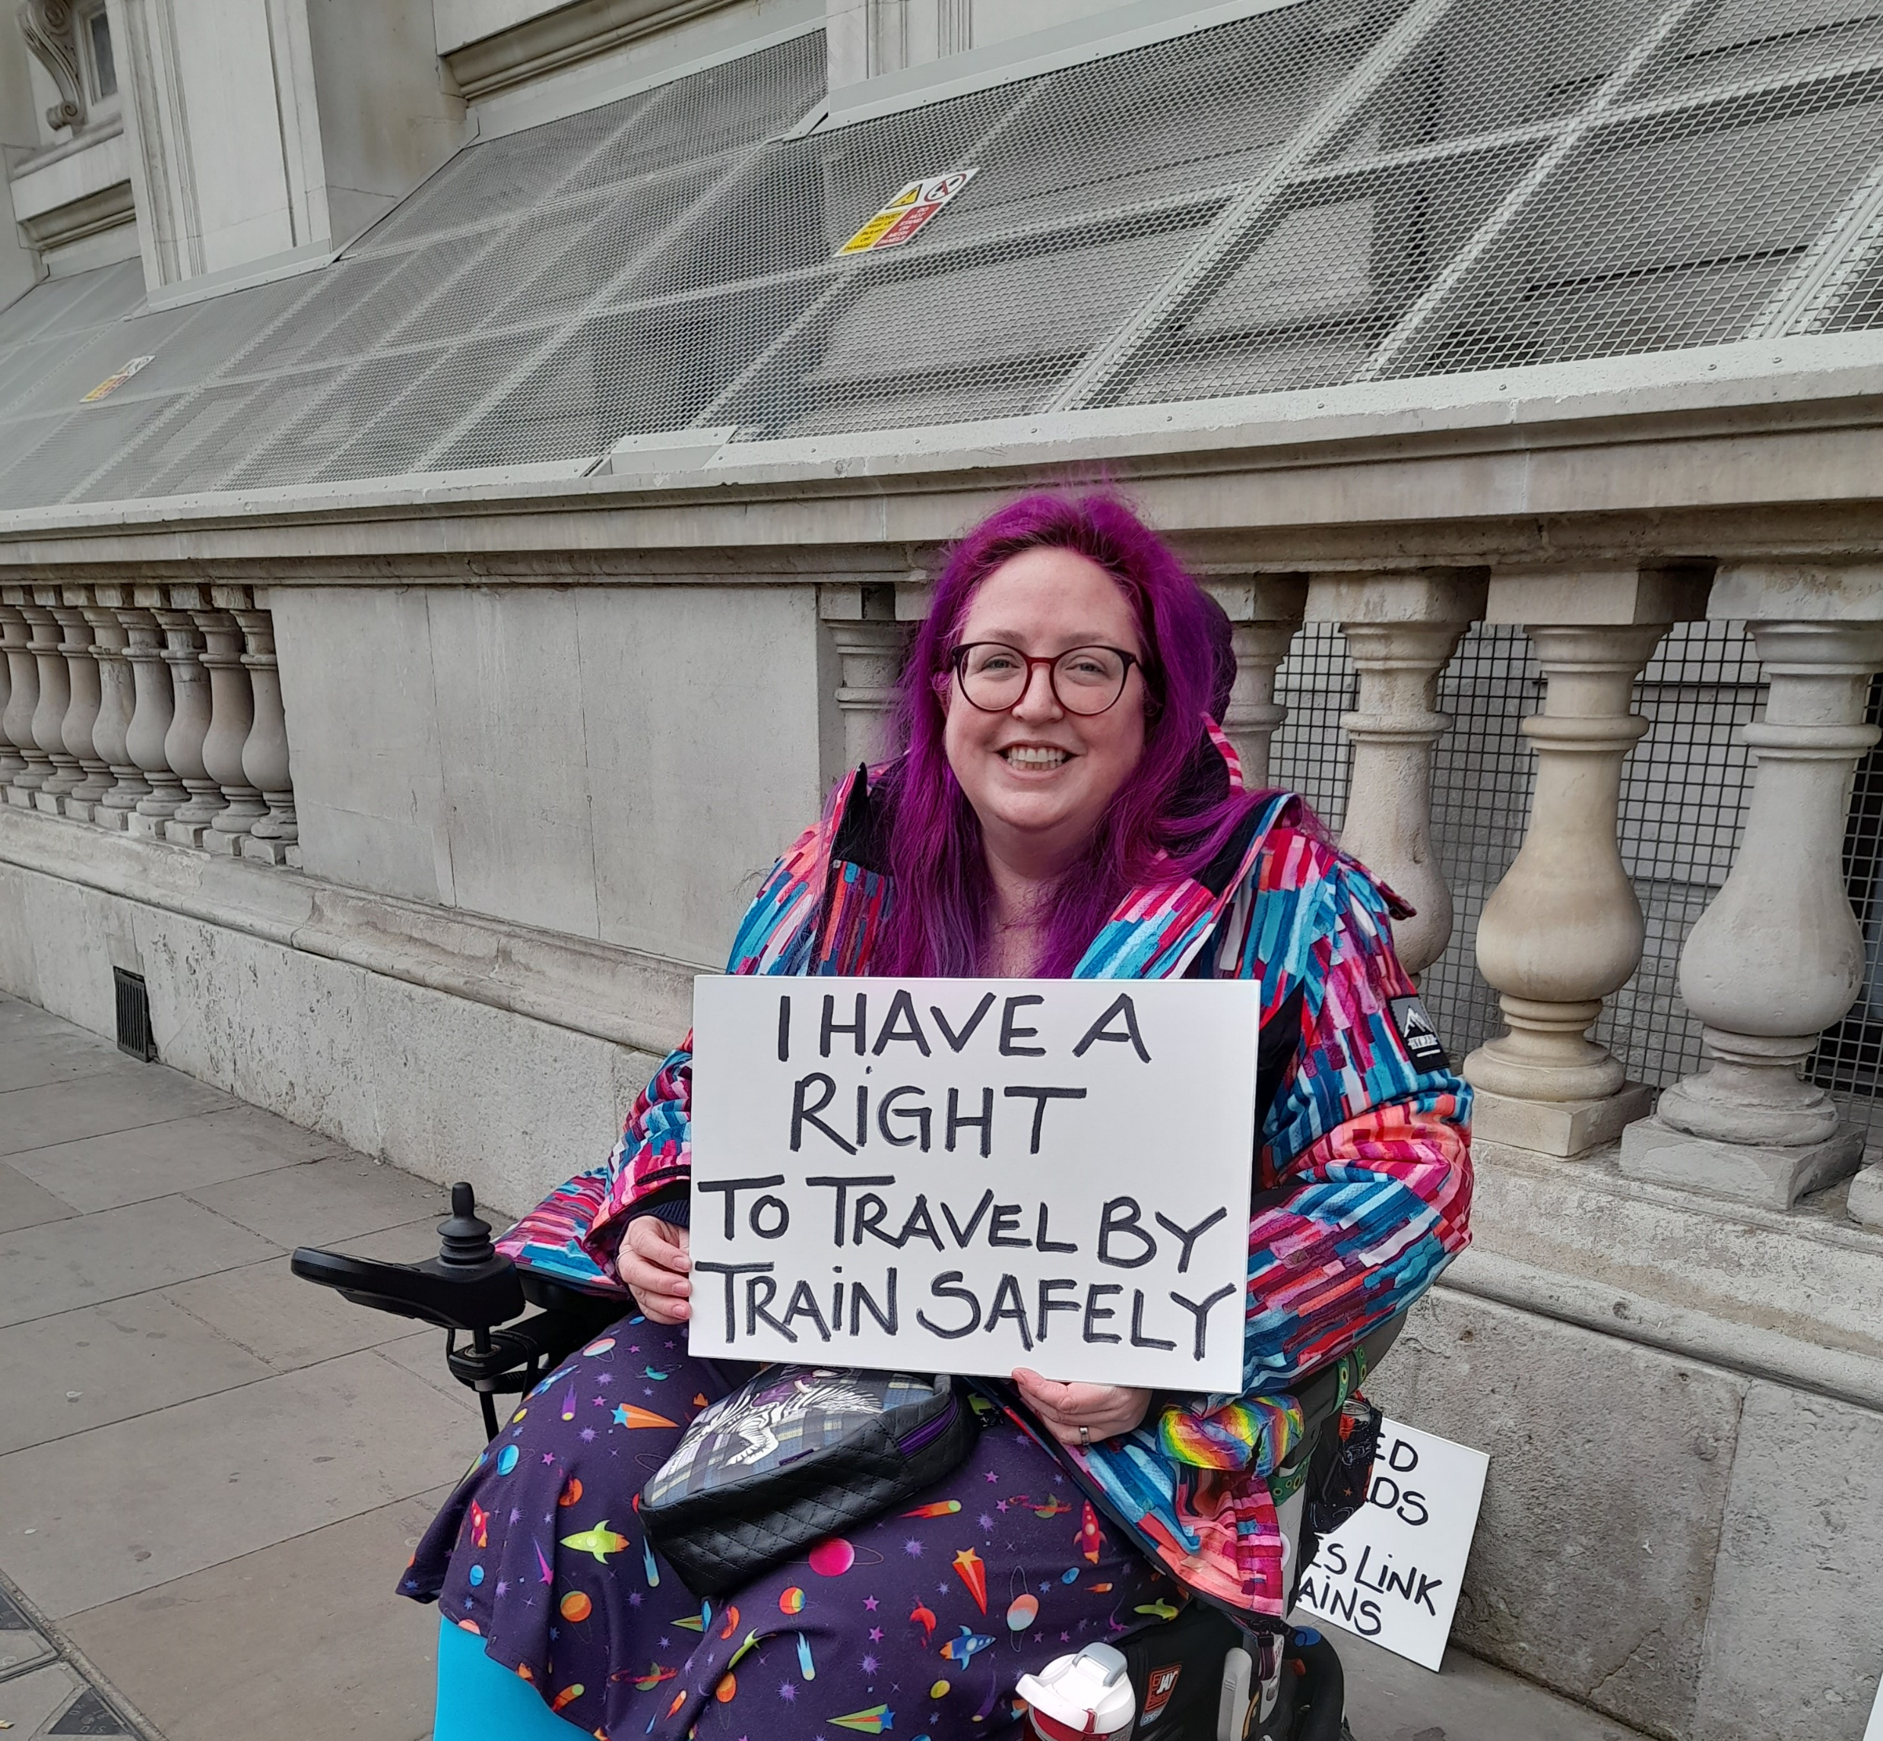
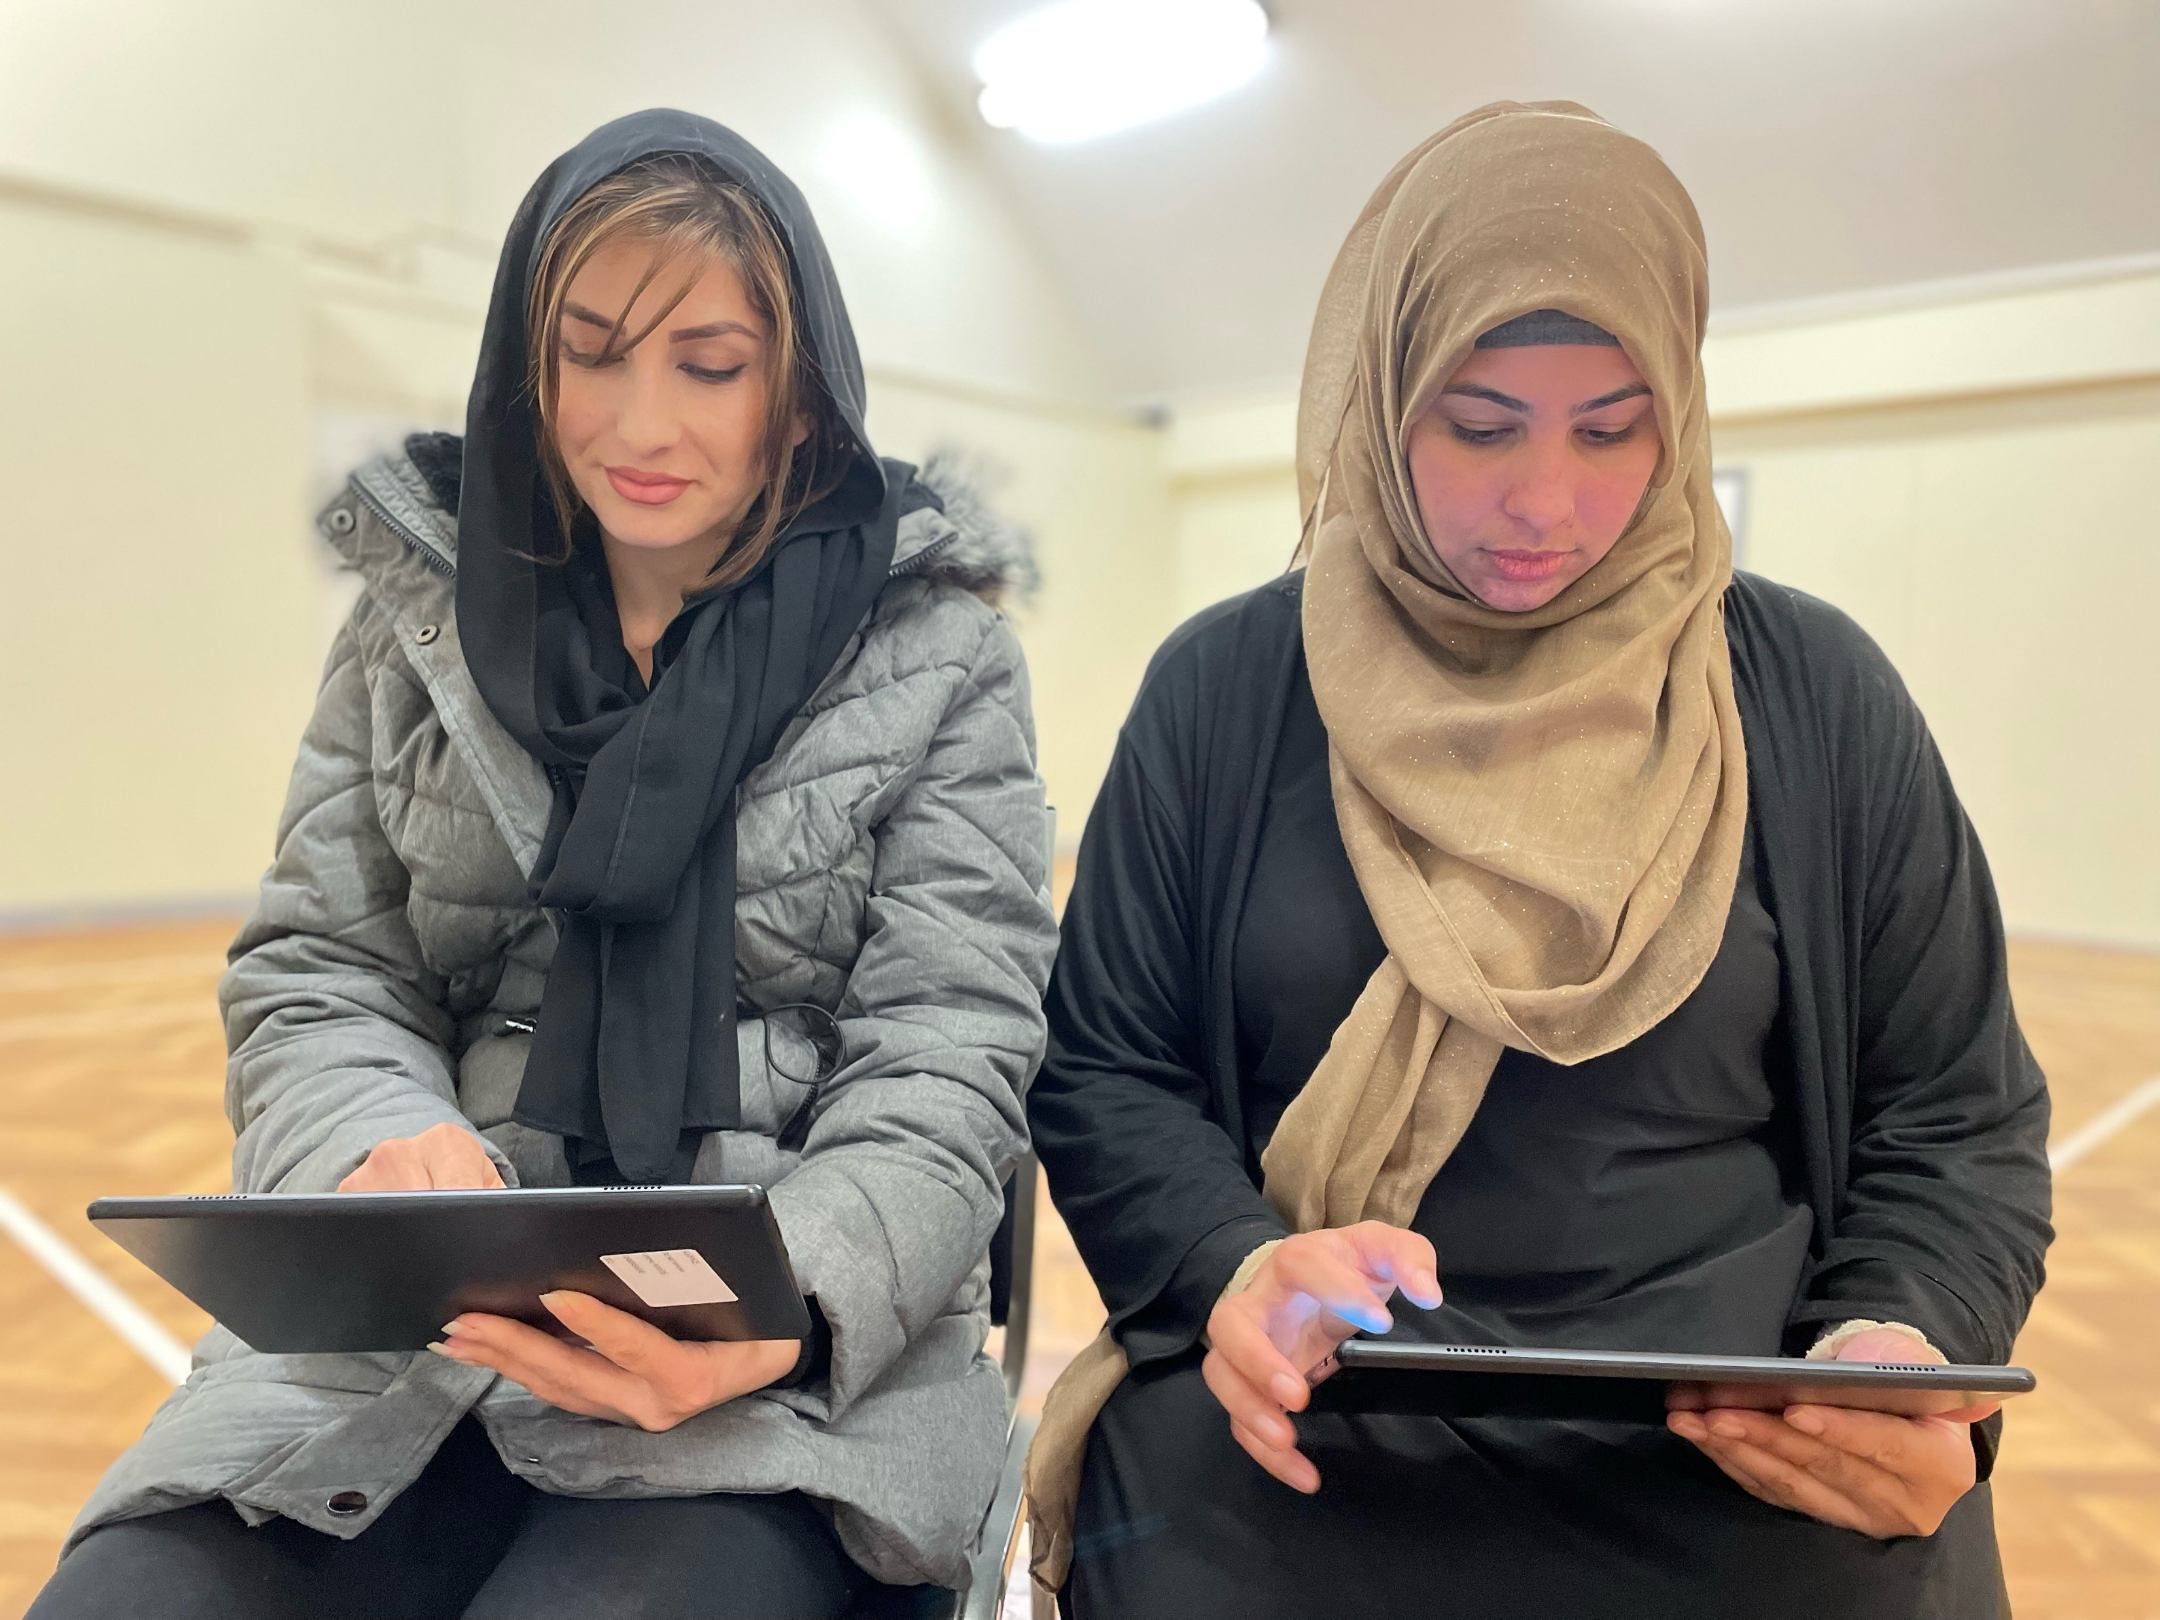
The difference we make..
“Joining The Coalition has been so helpful. I’ve met so many other people that experience daily challenges, it’s changed my perspective on what can be achieved and has made me feel less isolated”

Slide 4
What is coproduction?
Tell us your thoughts?
Notes:
Ask this question to the people in the workshop and collate ideas on a flip chart?

Slide 5
Co-production definition
“Co‑production is a way of working that involves people who use health and care services, carers and communities in equal partnership; and which engages groups of people at the earliest stages of service design, development and evaluation.
“Co‑production acknowledges that people with ‘lived experience’ of a particular condition are often best placed to advise on what support and services will make a positive difference to their lives. Done well, co‑production helps to ground discussions in reality, and to maintain a person‑centred perspective. Co‑production is part of a range of approaches that includes citizen involvement, participation, engagement and consultation.”

Slide 6
Coproduction Ladder
The ladder describes a series of steps towards co-production in health and social care. It supports greater understanding of the various stages of access and inclusion before full co-production is achieved.

Slide 7
Via Think Local Act Personal Website
Notes:
The ladder is split into different sections – we’ll talk in more detail about each of the sections over the next few slides.

Slide 8
Doing to….
Coercion
The bottom of the ladder. Coercing people to attend an event or hear about services without their views being considered
Educating
Telling people about the service…that’s it…very one way!

Slide 9
Doing for
Informing
Telling people about the services and how they work. This may include some description about why the decisions were made.
Consultation
Encouraging people to complete surveys, write a response to a proposed policy with no opportunity to change things!
Engagement
More surveys and responses with SOME influence over the decisions being made

Slide 10
Doing with..
Co-design
People who use services are involved in designing services, based on their experiences and ideas. They have genuine influence but have not been involved in strategic decision-making.
Co-production
Co-production is an equal relationship between people who use services and the people responsible for services. They work together, from design to delivery, sharing strategic decision-making about policies as well as decisions about the best way to deliver services.

Slide 11
Where on the ladder do you want to be?!

Slide 12
The perfect coproduction recipe?!
Split yourselves into groups and tell us the ingredients you need to make the perfect coproduction sponge/flapjack or brownie! (Or whatever else takes your fancy!)
Just 5 mins and please assign a person to feedback!

Slide 13
What did you come up with?!

Slide 14
Six principals of coproduction
The National Economics Forum (NEF) have six principles of co-production that are needed for effective co-production to take place:
1. Recognise people as informative resources.
2. Build on people’s existing capabilities.
3. Develop mutuality and reciprocity.
4. Share knowledge by engaging with peer support networks.
5. Break down barriers between those who deliver services and those who
access.
6. Facilitate discussions rather than telling people and communities what they need.

Slide 15
The benefits of coproduction – for the organisation
Engaging local people in the development, monitoring, and evaluation of health and social care provision can help build trust between the Local Authority and the community that it serves.
It can demonstrate to local people that the council not only listens to their views but considers their contributions and ideas to support better outcomes.
The Care Quality Commission (CQC) currently lists co-production as number one of its six principles that it wants the organisations it regulates to provide evidence of:
“1. Develop and deploy innovations with the people who use them”.
– Care Quality Commission
The Association of Directors of Adult Social Services (ADASS) defines co-production as:
“[U]sing the experience of those who use services can reduce and re-direct wasteful spending which is not having an impact. [It] can also increase the reach and impact of public services”.

Slide 16
Benefits of coproduction for the person with lived experience
There are many personal benefits to being involved with co-production, below are some examples:
Provides the opportunity to have your voice and experiences heard.
Can make you feel valued and valuable with a sense of belonging, connection, and community.
Allows you to support service development.
For personal growth. You’ll gain skills, knowledge, and confidence.
It can be interesting, enjoyable, and can support your personal wellbeing.
A chance to access peer support e.g., buddies, mentoring, reflective spaces.
Connects you with others who have shared experiences.
You will receive recognition, appreciation, and celebration.

Slide 17
Things to consider before embarking on coproduction
Is the balance of power genuinely equal in decision making?
Are there mutually agreed responsibilities and expectations?
Are you able to support people taking part?
Can you commit to people with lived experience playing an equal role in delivery?
Do you have time for the process to take place meaningfully?
Notes:
To be called coproduction there must be a genuinely equal and reciprocal relationship between staff and people with lived experience. All contributions are valuable.
Consider how you will support people to take part? Both in a practical way and in an emotional way. Very often a person with lived experience will need some support prior to the coproduction and following the coproduction. For example, sharing their experience of their mental ill health may be a trigger so it’s important that they have somebody to talk to following the sessions. Some people with lived experience may need transport to a meeting or other support – do you have the budget to support this? It’s important that coproduction is accessible to all.
Finally ensure there is some budget for payment for the people with lived experience.

Slide 18
Payment for coproduction
Physical Disability and Sensory Impairment Strategy
Coproduced with Surrey County Council
People with lived experience coproduced the strategy
Notes:
One of the core principles of co-production, ‘reciprocity’, highlights the need to recognise people’s contributions by giving something back for the work that they do. Offering payment for involvement in co-production and other similar activities can increase participation and help to reduce potential power imbalances. It offers a way to acknowledge the time, skills, and expertise that people with lived experience can contribute to the development of services. It makes the process more inclusive as it can support people to co-produce who might not otherwise have been able to take part, whether for financial or other reasons related to access. It also widens the potential group of people who might influence service development.
Those facilitating the co-production activity should provide attendees with information regarding payment, impact on benefits, and the legal obligations to disclose any payments made.
We have worked with Surrey County Council and Surrey and Borders Partnership to develop a coproduction payment policy.

Slide 19
Case studies
Physical Disability and Sensory Impairment Strategy
Coproduced with Surrey County Council
People with lived experience coproduced the strategy
Notes:
Adult Social Care Vision
To promote people's independence and wellbeing, through personalised care and support that focuses upon their strengths, the outcomes they want to achieve and enables choice and control.
We want Surrey to be a place that offers opportunities for people to live healthy and fulfilling lives, where people's contributions to their local communities are welcomed, supported and valued, and no one is left behind.
People with disabilities have told us that there are significant barriers to achieving our vision across the service system and the wider community. Addressing these barriers will require better understanding of disabilities, and culture change across Surrey's workforce, services and community.
The work of the strategy will need to be embedded in organisations and the wider community so that it is sustained and can be built on. The strategy is here to focus the action of all the partners across Surrey who will work together to make the changes we need to see.
Since the strategy was launched, a disability partnership board has now been established to oversee the implementation of the strategy

Slide 20
Safe Havens
Independent Mental Health Network (IMHN) staff and members were involved with the Epsom and Aldershot location changes. IMHN brought together a group of people with lived experience of using these safe havens and knowledge of these areas.
The group provided service user views on property options and locations. the way.
Provider organisations and the commissioners from Surrey Heartlands and Frimley worked with the IMHN sub-group at regular points throughout both the relocations, making sure decisions were made together until appropriate solutions were found.
The IMHN members also assisted with the design and launch of a young adult Safe Haven in Guildford.
Notes:
As well as providing accessibility advice about the sites to SABP property department. Service users provided insight about travelling alone at night to these sites whilst in mental health crisis and what needed to be the considered about the walk from bus and train stations, feelings of safety, lighting and signposting along the way.

Slide 21
Questions?

