Slide 1

Reserves Policy !
Where’s the Budget ?
Brian Seaton
Lead Trustee
Notes:
Thank you for joining this webinar.
The title is a bit of a mouthful, I’m afraid.
CLICK → → →

Slide 2
Reserves Policy !
Where’s the Budget ?
What are “Reserves” ?
Why must charities have a policy ?
What does the policy have to say ?
What’s the problem ?
What’s the solution ?
Notes:
Thank you for joining this webinar.
The title is a bit of a mouthful, I’m afraid.
CLICK → → →

Slide 3
Dictionary Definitions of “Reserve(s)”
https://dictionary.cambridge.org/dictionary/english/reserve
to keep something for a particular purpose or time,
if you reserve something such as a seat on an aircraft or a table at a restaurant, you arrange for it to be kept for your use;
keeping something or a supply of something until it is needed,
she keeps a little money in reserve, for use if and when needed;
an area of land kept in its natural state,
especially for wild animals to live in and be protected;
in sports, an extra player who is ready to play if needed,
also, a group of people who are not permanently in the armed forces but are used only if needed;
the lowest amount of money the owners will accept for something being sold;
reserve judgement, to not decide on something immediately.
Notes:
So, for the rest of this webinar I’m going to the title I suggested originally, which is rather shorter – and a bit more “philosophical”
CLICK → → →

Slide 4
Dictionary Definitions of “Reserve(s)”
https://dictionary.cambridge.org/dictionary/english/reserve
“Legal Reserves”
https://dictionary.cambridge.org/dictionary/english/legal-reserves
“the smallest amount of money that financial organizations
such as banks must keep to protect themselves
against future financial losses, to pay legal fees, etc”
Notes:
So, for the rest of this webinar I’m going to the title I suggested originally, which is rather shorter – and a bit more “philosophical”
CLICK → → →

Slide 5
Definitions of Charity “Reserve(s)”
Charities Act 2011
https://www.legislation.gov.uk/ukpga/2011/25/pdfs/ukpga_20110025_en.pdf
Only makes one use of the word – and it is NOT defined in the glossary
98 Provisions which may be included in common investment schemes
(3) Where a scheme makes any such provision it must also provide for excluding from the amount of capital and income to be shared between charities participating otherwise than by way of deposit such amounts (not exceeding the amounts properly attributable to the making of deposits) as are from time to time reasonably required in respect of the liabilities of the fund—
(a) for the repayment of deposits, and
(b) for the interest on deposits,
including amounts required by way of reserve.
Notes:
So, for the rest of this webinar I’m going to the title I suggested originally, which is rather shorter – and a bit more “philosophical”
CLICK → → →

Slide 6
Definitions of Charity “Reserve(s)”
FRS-102
https://www.frc.org.uk/documents/7668/FRS_102_September_2024.pdf
Plenty of uses of the word – eg:
cash flow hedge reserve; revaluation reserve;
fair value reserve; capital redemption reserve
and a ubiquitous “other reserves”
but “Reserves” are NOT defined in the glossary
The FRS-102 makes no explicit reference to “charity reserves”
Notes:
So, for the rest of this webinar I’m going to the title I suggested originally, which is rather shorter – and a bit more “philosophical”
CLICK → → →

Slide 7
Definitions of Charity “Reserve(s)”
Charities SORP
https://www.charitysorp.org/download-a-full-sorp
Some specific uses of the word – eg:
pension reserve; revaluation reserve; fair value reserve;
but mostly use of unspecific “reserves”
but “Reserves” are NOT defined in the glossary
other than to refer the reader to the SORP module on
preparing the Trustees Annual Report
Notes:
So, for the rest of this webinar I’m going to the title I suggested originally, which is rather shorter – and a bit more “philosophical”
CLICK → → →

Slide 8
Definitions of Charity “Reserve(s)”
Charities SORP
https://www.charitysorp.org/download-a-full-sorp
Financial review
1.21. The {trustees’ annual} report must contain a review of the charity’s financial position at the end of the reporting period.
1.22. The charity must explain any policy it has for holding reserves and state the amounts of those reserves and why they are held.
If the trustees have decided that holding reserves is unnecessary, the report must disclose this fact and provide the reasons behind this decision.
1.48. The review of the charity’s reserves should: ⬇
state the amount of the total funds the charity holds at the end of the reporting period;
identify the amount of any funds which are restricted and not available for general purposes of the charity at the end of the reporting period;
identify and explain any material amounts which have been designated or otherwise committed as at the end of the reporting period;
indicate the likely timing of the expenditure of any material amounts designated or otherwise committed at the end of the reporting period;
identify the amount of any fund that can only be realised by disposing of tangible fixed assets or programme related investments;
state the amount of reserves the charity holds at the end of the reporting period after making allowance for any restricted funds, and the amount of designations, commitments (not provided for as a liability in the accounts) or the carrying amount of functional assets which the charity considers to represent a commitment of the reserves they hold; and
compare the amount of reserves with the charity’s reserves policy and explain, where relevant, what steps it is taking to bring the amount of reserves it holds into line with the level of reserves identified by the trustees as appropriate given their plans for the future activities of the charity.
Notes:
So, for the rest of this webinar I’m going to the title I suggested originally, which is rather shorter – and a bit more “philosophical”
CLICK → → →

Slide 9
Definitions of Charity “Reserve(s)”
CC19: Charity Reserves: Building Resilience
https://www.gov.uk/government/publications/charities-and-reserves-cc19/charities-and-reserves
3.1 What are reserves?
Reserves are that part of a charity’s unrestricted funds that is freely available to spend on any of the charity’s purposes.
The starting point for calculating the amount of reserves held is therefore the amount of unrestricted funds held by a charity. ⬇
The items that should be excluded from reserves are:
tangible fixed assets used to carry out the charity’s activities
social investments
designated funds set aside to meet essential future spending
commitments that have not been provided for as a liability in the accounts
restricted funds
Notes:
So, for the rest of this webinar I’m going to the title I suggested originally, which is rather shorter – and a bit more “philosophical”
CLICK → → →

Slide 10
Reserves Policy !
Where’s the Budget ?
What are “Reserves” ?
Why must charities have a policy ?
Notes:
Thank you for joining this webinar.
The title is a bit of a mouthful, I’m afraid.
CLICK → → →

Slide 11
Why Have a Reserves Policy ?
CC19: Charity Reserves: Building Resilience
https://www.gov.uk/government/publications/charities-and-reserves-cc19/charities-and-reserves
4.1 Explaining the charity’s reserves policy in its annual report
The requirements for ALL charities
ALL charities must include in their annual report their policy on reserves, stating the level of reserves held and why they are held.
Where the charity does not have a reserves policy in place, it should include a statement to that effect. ⬇
5.2 What is the legal basis for holding and reporting reserves?
Charity trustees have a general legal duty to spend income within a reasonable time of receipt.
A failure to report on the charity’s reserves policy can indicate that trustees have not exercised their legal power correctly.
Notes:
So, for the rest of this webinar I’m going to the title I suggested originally, which is rather shorter – and a bit more “philosophical”
CLICK → → →

Slide 12


Public Trust in Charities
Long title | An Act to redress the Mis-employment of Lands, Goods and Stocks of Money heretoforegiven to certain charitable Uses.
Citation | 43 Eliz. 1. c. 4
Royal assent | 19 December 1601
https://en.wikipedia.org/wiki/Charitable_Uses_Act_1601
Notes:
Thank you for joining this webinar.
The title is a bit of a mouthful, I’m afraid.
CLICK → → →

Slide 13
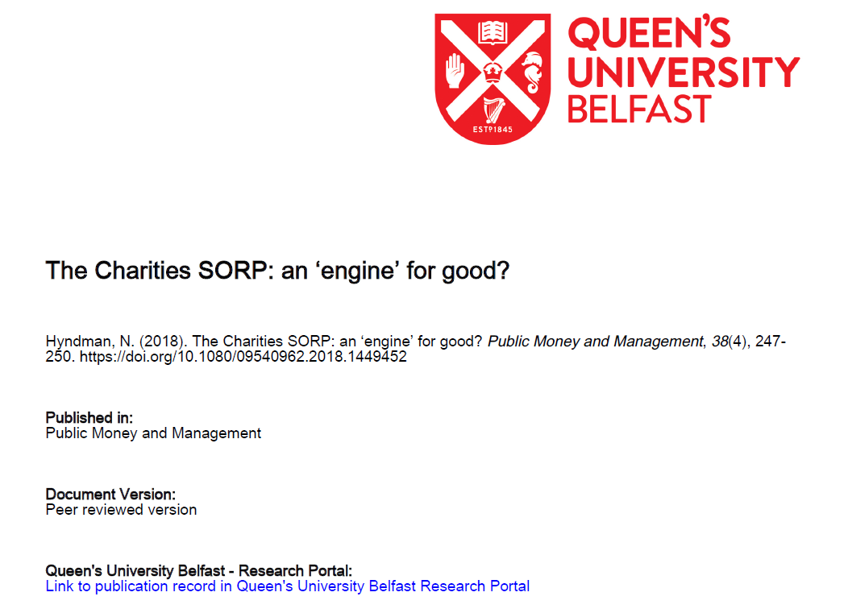
Public Trust in Charities
Until the late 1980s, accounting and reporting by charities in the UK was frequently very poor, evidenced by limited transparency and resulting in weak accountability.
The Charities SORP:
an engine for good?
Hyndman N. (2018)
Public Money and Management, 38(4) 247-250
Copyright © acknowledged
A trigger for change occurred with
the publication of research by Bird and Morgan-Jones (1981).
Among the many very dubious, and widespread, accounting treatments identified by the researchers (many of which had the objective of understating surpluses, or overstating losses), was the common practice of crediting legacy income (in full or partially) to capital rather than income.
Given that some charities received considerable proportions of their funding from such sources, this had the effect of significantly understating the revenue result (presumably as a means of attracting donations).
The first charities SORP was issued in 1988.
And made the primary legal standard for charities in the 1992 Charities Act
https://pure.qub.ac.uk/files/155631755/PMM_Charities_SORP_Engine_for_Good_Accepted_Manuscript_April_2018_Pure.pdf
Notes:
Thank you for joining this webinar.
The title is a bit of a mouthful, I’m afraid.
CLICK → → →

Slide 14
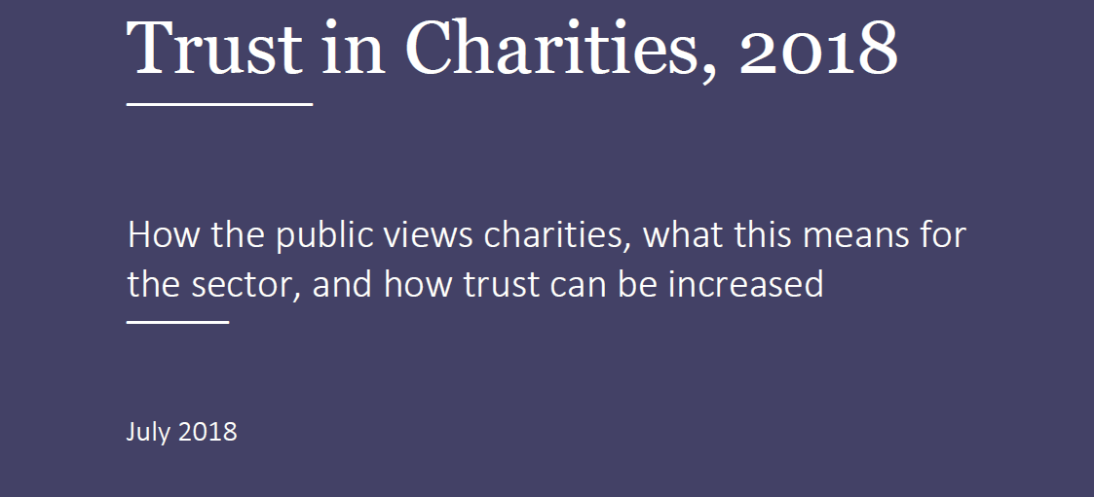

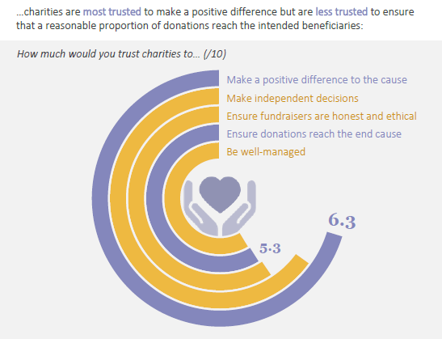
https://assets.publishing.service.gov.uk/media/5b4348ade5274a377077462f/Charity_Commission_-_Trust_in_Charities_2018_-_Report.pdf
Notes:
So, for the rest of this webinar I’m going to the title I suggested originally, which is rather shorter – and a bit more “philosophical”
CLICK → → →

Slide 15




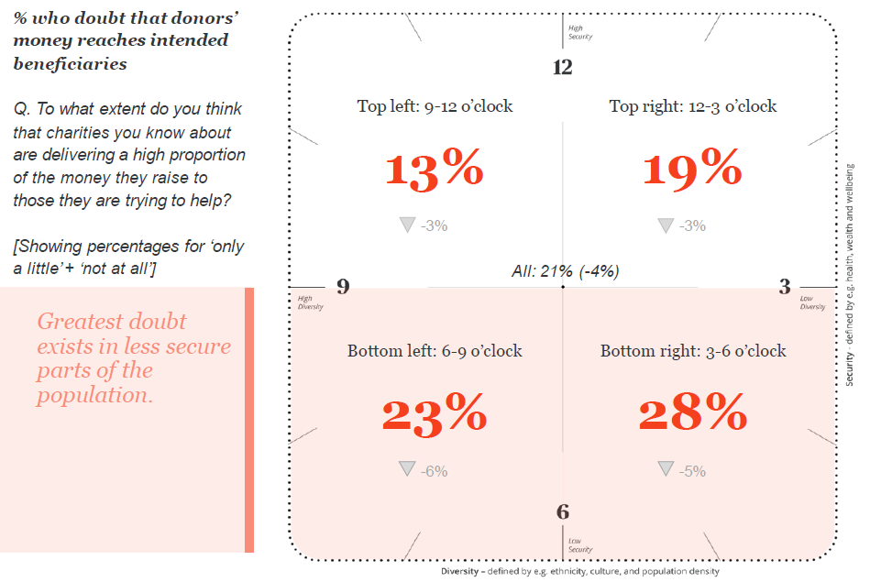
https://assets.publishing.service.gov.uk/media/649acaf22caa3e000c3e5f39/Public_trust_in_charities_2022-23.pdf
Notes:
So, for the rest of this webinar I’m going to the title I suggested originally, which is rather shorter – and a bit more “philosophical”
CLICK → → →

Slide 16
Public Trust in Charities
CC19: Charity Reserves: Building Resilience
https://www.gov.uk/government/publications/charities-and-reserves-cc19/charities-and-reserves
3.2 Why is a Reserves Policy Important ?
a reserves policy will:
give confidence to funders by demonstrating good stewardship and active financial management;
demonstrate the charity’s resilience and capacity to manage unforeseen financial difficulties to beneficiaries, funders and the public;
give funders, such as grant-makers, an understanding of why funding is needed to undertake a particular project or activity;
give assurance to lenders and creditors that the charity can meet its financial commitments;
manage the risk to a charity’s reputation from holding substantial unspent funds at the year-end without explanation.
Notes:
So, for the rest of this webinar I’m going to the title I suggested originally, which is rather shorter – and a bit more “philosophical”
CLICK → → →

Slide 17
Reserves Policy !
Where’s the Budget ?
What are “Reserves” ?
Why must charities have a policy ?
What does the policy have to say ?
Notes:
Thank you for joining this webinar.
The title is a bit of a mouthful, I’m afraid.
CLICK → → →

Slide 18


https://www.gov.uk/government/publications/charities-and-reserves-cc19/charities-and-reserves
2. Key messages for trustees {abbreviated}
As the regulator of charities in England and Wales, the Commission expects trustees to decide, publish, implement and monitor their charity’s reserves policy so that they can comply with their legal duties.
In practice, this means that trustees should:
develop a reserves policy that:
  fully justifies and clearly explains keeping or not keeping reserves;
  identifies and plans for the maintenance of essential services for beneficiaries;
  reflects the risks of unplanned closure associated with the charity’s business model, spending commitments, potential liabilities and financial forecasts; ⬇
  helps to address the risks of unplanned closure on their beneficiaries (in particular, vulnerable beneficiaries), staff and volunteers;
ensure that the policy is tailored to the charity’s circumstances – it should not be just a standard form of wording;
regularly monitor and review the effectiveness of the policy in the light of the changing funding and financial climate and other risks.
Notes:
Thank you for joining this webinar.
The title is a bit of a mouthful, I’m afraid.
CLICK → → →

Slide 19
https://www.gov.uk/government/publications/charities-and-reserves-cc19/charities-and-reserves
3. Understanding reserves and the need for a reserves policy
3.1 What are reserves?
Reserves are that part of a charity’s unrestricted funds that is freely available to spend on any of the charity’s purposes.
However, some or all of the unrestricted funds of a charity may not be readily available for spending. This is because spending those funds may adversely impact on the charity’s ability to deliver its aims.
The items that should be excluded from reserves are:
tangible fixed assets used to carry out the charity’s activities;
social investments;
designated funds set aside to meet essential future spending, such as funding a project that could not be met from future income
commitments that have not been provided for as a liability in the accounts
Restricted funds
Restricted funds fall outside the definition of reserves, but the nature and amount of such funds may impact on a charity’s reserves policy.
Notes:
Thank you for joining this webinar.
The title is a bit of a mouthful, I’m afraid.
CLICK → → →

Slide 20

What are “Reserves” ?
Why must charities have a policy ?
What does the policy have to say ?
What’s the problem ?
Notes:
Thank you for joining this webinar.
The title is a bit of a mouthful, I’m afraid.
CLICK → → →

Slide 21

What’s the Problem ?
“Reserves” =
'I don't know what you mean by “reserves",’ Alice said.
Humpty Dumpty smiled contemptuously.
'Of course you don't — till I tell you.
I meant "there's a nice knock-down argument for you!"'
'But “reserves" doesn't mean "a nice knock-down argument",' Alice objected.
'When I use a word,' Humpty Dumpty said, in rather a scornful tone, 'it means just what I choose it to mean — neither more nor less.'
With apologies (and thanks) to Lewis Carroll
Notes:
The other confusing Humpty-Dumpty-ism is the way that the word “Accounts” to mean many different things, depending on the context.
Which is fine for those who regularly engage in the finance sector. But it can be very confusing those who don’t.
For example:
if guidance material, or a webinar like this one, is talking about a charity’s “accounts”, is it talking about the charity’s financial records (often called bookkeeping instead)
Or about the charity’s routine operational reports
CLICK → → →

Slide 22
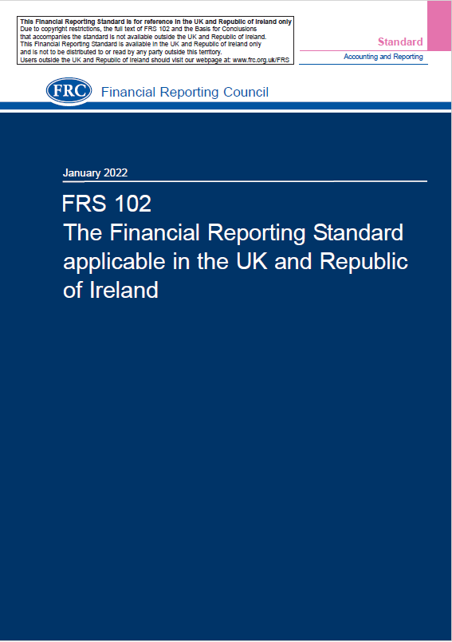

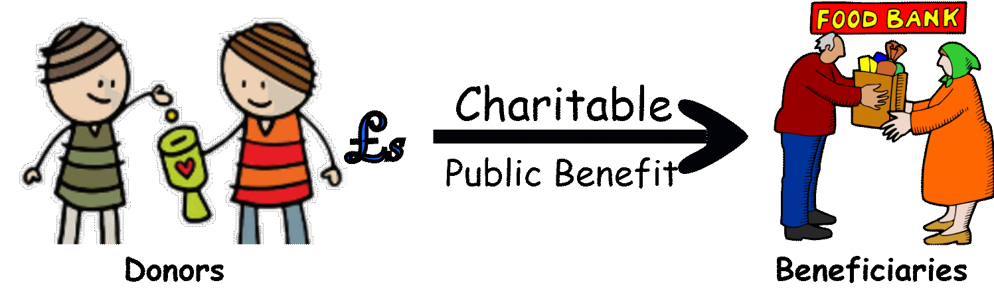
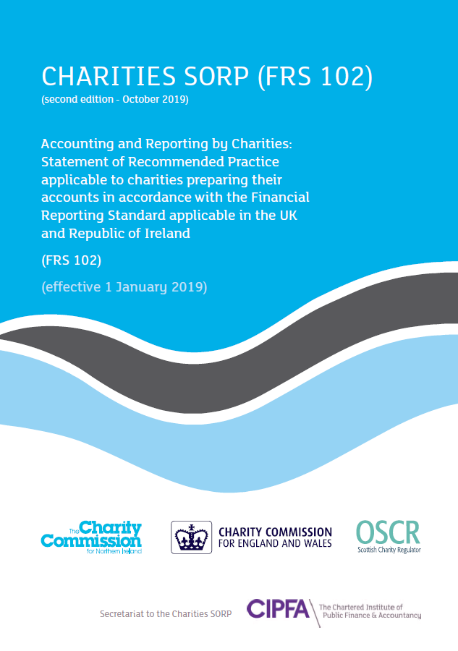
What’s the Problem ?
400+
Pages!
The commercial sector is “in the business” of utilising its financial resources to
accumulate even more financial resources for the benefit of its investors and shareholders.
The charity sector is “in the business” of spending its financial resources to
generate goods, services and activities for its beneficiaries and for the public benefit.
200+
Pages !
Notes:
The other confusing Humpty-Dumpty-ism is the way that the word “Accounts” to mean many different things, depending on the context.
Which is fine for those who regularly engage in the finance sector. But it can be very confusing those who don’t.
For example:
if guidance material, or a webinar like this one, is talking about a charity’s “accounts”, is it talking about the charity’s financial records (often called bookkeeping instead)
Or about the charity’s routine operational reports
CLICK → → →

Slide 23
What’s the Problem ?
400+
Pages!
The commercial sector likes to see money – ie: profits – rolling INTO its bank accounts.
Because that means more “spare cash” to pay out as dividends to its shareholder
The charity sector likes to see money rolling OUT OF it bank accounts.
Because supporters like to see their donations/grants getting to their intended beneficiaries.
200+
Pages !
Notes:
The other confusing Humpty-Dumpty-ism is the way that the word “Accounts” to mean many different things, depending on the context.
Which is fine for those who regularly engage in the finance sector. But it can be very confusing those who don’t.
For example:
if guidance material, or a webinar like this one, is talking about a charity’s “accounts”, is it talking about the charity’s financial records (often called bookkeeping instead)
Or about the charity’s routine operational reports
CLICK → → →

Slide 24
What’s the Problem ?
400+
Pages!
If it takes 200+ pages of a Charity SORP to explain how to apply 400+ pages of
commercial financial rules, regulations and accountancy jargon to the charity sector…
…why are we surprised that the vast majority of small charities find
those financial rules and jargon NOT FIT FOR PURPOSE ?
200+
Pages !
Notes:
The other confusing Humpty-Dumpty-ism is the way that the word “Accounts” to mean many different things, depending on the context.
Which is fine for those who regularly engage in the finance sector. But it can be very confusing those who don’t.
For example:
if guidance material, or a webinar like this one, is talking about a charity’s “accounts”, is it talking about the charity’s financial records (often called bookkeeping instead)
Or about the charity’s routine operational reports
CLICK → → →

Slide 25
What’s the Problem ?
“Reserves” – definitions in the Commercial Sector {from the Internet}
In accounting, reserves are portions of a company's profits that are set aside for specific or general purposes. https://www.indeed.com/career-advice/career-development/what-is-a-reserve-in-accounting
In financial accounting, reserve always has a credit balance and can refer to a part of shareholders' equity, a liability for estimated claims, or contra-asset for uncollectible accounts.
https://en.wikipedia.org/wiki/Reserve_(accounting)
Reserves are profits that have been appropriated, or set aside, to be used for a specific purpose further down the line. https://gocardless.com/guides/posts/reserve-accounting/
Balance sheet reserves, also known as claims reserves, are accounting entries that show money set aside to pay future obligations. https://www.investopedia.com/terms/b/balance-sheet-reserves.asp
Simply put, reserves are profits a company has made that are set aside for a specific purpose in the future. https://businessfinancing.co.uk/accounting/reserves-in-accounting/
A reserve is profits that have been appropriated for a particular purpose,
https://www.accountingtools.com/articles/what-is-reserve-accounting.html
Think of your reserves as like the suspension in a car, smoothing out bumps in the road and stopping the wheels falling off. Keeping some of your profits in reserve, rather than paying them out as dividends immediately, enables you to cover unplanned costs when they arise and avoid dipping into salaries or cutting dividends later.
https://www.sage.com/en-gb/blog/capital-and-reserves/ ⬇
“Reserves” – definition in the Charity Sector {from Charity Commission guidance}
Reserves are that part of a charity’s unrestricted funds that is freely available to spend on any of the charity’s purposes.
https://www.gov.uk/government/publications/charities-and-reserves-cc19/charities-and-reserves
Notes:
Thank you for joining this webinar.
The title is a bit of a mouthful, I’m afraid.
CLICK → → →

Slide 26

What’s the Problem ?
Charities SORP: Scope and Application
17. The accounting recommendations of this SORP
do not apply to charities preparing cash-based receipts and payments accounts.
Charities preparing cash-based receipts and payments accounts must refer to the regulatory requirements
of their jurisdiction(s) of registration regarding the format and content requirements for receipts and payments accounts and the trustees’ annual report.
Charity Commission: CC19 Charity Reserves: Building Resilience
Charities SORP (FRS102) ….. sets out the recommended practice for preparing the trustees’ annual report and preparing accounts on an accruals basis.
It does not apply to charities preparing receipts and payments accounts.
Charity Commission: CC16b Receipts and Payments Introductory Notes
The guidance and templates for both the Trustees’ Annual Report and the Annual Accounts makes no reference whatsoever to Reserves or to Reserves Policies ⬇
Notes:
Thank you for joining this webinar.
The title is a bit of a mouthful, I’m afraid.
CLICK → → →

Slide 27
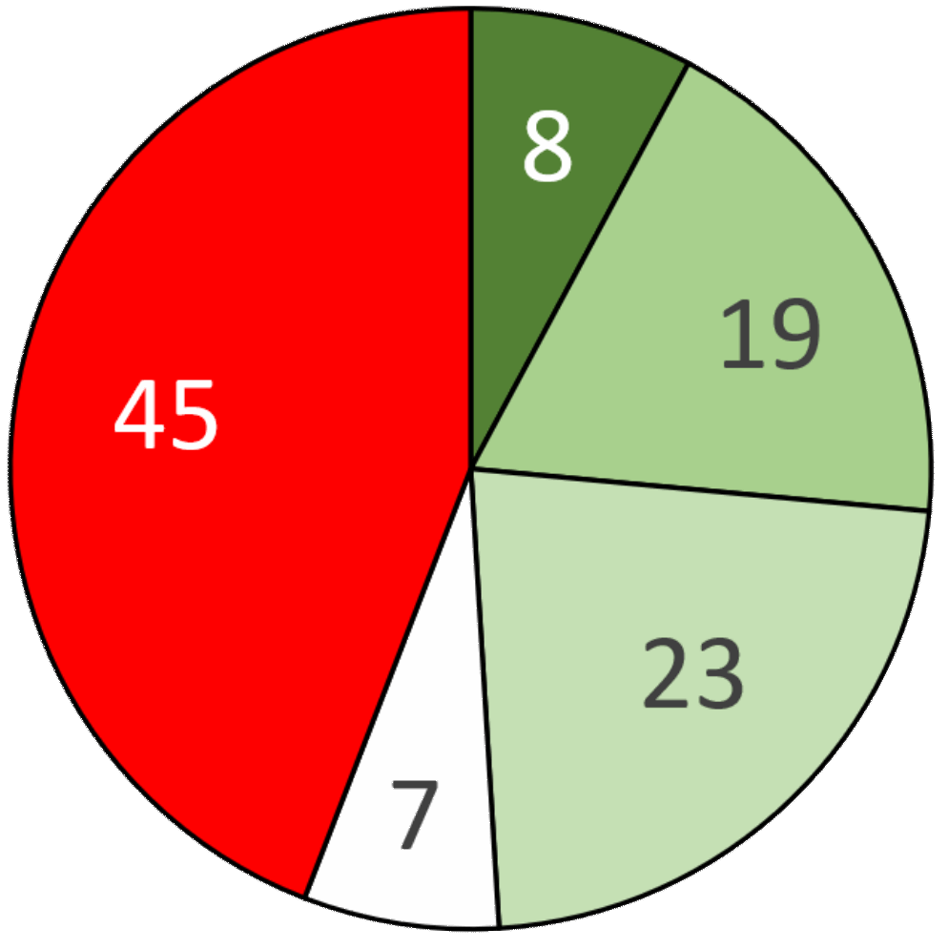
The Evidence
Small Charity Support Review, Jan’24
Specific
Period
No Policy Statement
Trustees’ Annual Reports
Reserves Policy Statements
102 Random Charities
£25,000 - £250,000
Vague
Not Required
Notes:
So, for the rest of this webinar I’m going to the title I suggested originally, which is rather shorter – and a bit more “philosophical”
CLICK → → →

Slide 28
The Evidence
Qualifications of the Independent Examiner
Notes:
So, for the rest of this webinar I’m going to the title I suggested originally, which is rather shorter – and a bit more “philosophical”
CLICK → → →

Slide 29
The Evidence
Charity Commission
Public letter to the Financial Reporting Council {May 2021}
https://www.smallcharitysupport.uk/images/Thoughts/NFfP-ChCom-FRC.pdf
"The focus of accounting standards is very much on the interests of the providers of risk capital to for-profit businesses. Charities are established for the public benefit and not as owner managed for-profit businesses and, although welcome, the PBE paragraphs are proving insufficient in addressing the reporting needs of the users or charity accounts and avoiding for-profit orientated disclosures detracting from the quality and character of public benefit accounting and reporting.“ ⬇
Caron Bradshaw, CEO of the Charity Finance Group
Article published in the Third Sector magazine {July 2021}
https://www.thirdsector.co.uk/trustees-major-charities-held-personally-liable-accounting-mistakes/governance/article/1722228
“The government’s drive to increase trust and transparency is to be welcomed by all. However, we need to break this long but flawed habit of shoehorning charities into regulation and legislation designed for the for-profit world to avoid the unintended and harmful consequences such an approach brings about for the third sector.”
Notes:
So, for the rest of this webinar I’m going to the title I suggested originally, which is rather shorter – and a bit more “philosophical”
CLICK → → →

Slide 30
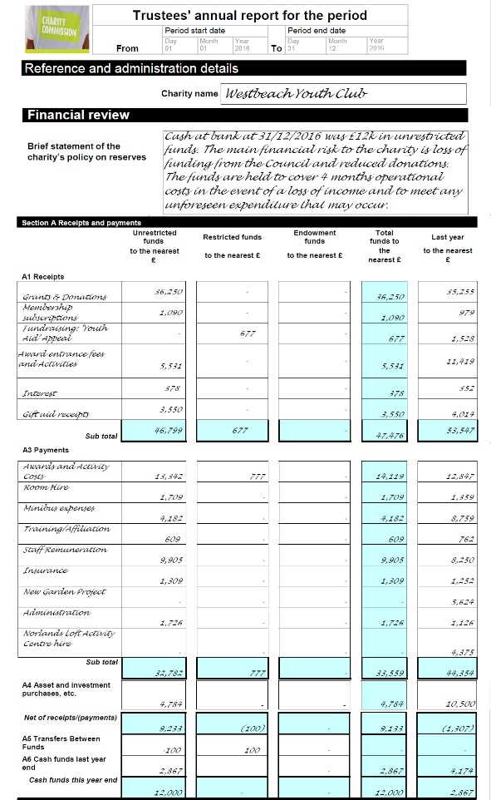
The Evidence
Cash at bank at 31/12/2016 was £12K in unrestricted funds. The main financial risk to the charity is loss of funding from the Council and reduced donations.
The funds are held to cover 4 months operational costs in the event of a loss of income and to meet any unforeseen expenditure that may occur.
Comments:
“The funds are held to cover 4 months operational costs…”. Is this just an observation of “fact”, or is it a consequence of the charity’s “Reserves Policy” ?
If the policy is “4 months”, why were the “reserves” reduced to a mere £2,867 (< 1 month’s operational costs) to buy a minibus in the previous year ?
Was the 50% reduction in “minibus expenses” due to cost-savings on activities costs ? If not – why ?
Why were participants’ contributions to “Awards Fees” reduced by 52% while costs increased by 10%?
Operational costs are significantly (>25%) less than income. How does that influence the risk of withdrawal of grants and donations ?
Notes:
So, for the rest of this webinar I’m going to the title I suggested originally, which is rather shorter – and a bit more “philosophical”
CLICK → → →

Slide 31
Reserves Policy !
Where’s the Budget ?
What are “Reserves” ?
Why must charities have a policy ?
What does the policy have to say ?
What’s the problem ?
What’s the solution ?
Notes:
Thank you for joining this webinar.
The title is a bit of a mouthful, I’m afraid.
CLICK → → →

Slide 32

What’s the Solution ?
We can't solve problems
by using the same kind of thinking
we used when we created them.
Albert Einstein
Notes:
Thank you for joining this webinar.
The title is a bit of a mouthful, I’m afraid.
CLICK → → →

Slide 33
Why Bother ?
https://www.gov.uk/government/publications/charities-and-reserves-cc19/charities-and-reserves
?
To get the required “tick in the box” when submitting the charity’s Trustees Annual Report & Accounts
To keep donors and funders “happy” and improve the chances of getting more donations/grants in future
?
?
To improve the financial management of the
charity and reduce the risk of financial crises
Notes:
Thank you for joining this webinar.
The title is a bit of a mouthful, I’m afraid.
CLICK → → →

Slide 34
Why Bother ?
https://www.gov.uk/government/publications/charities-and-reserves-cc19/charities-and-reserves
?
To improve the financial management of the
charity and reduce the risk of financial crises
To keep donors and funders “happy” and improve the chances of getting more donations/grants in future
?
?
To get the required “tick in the box” when submitting the charity’s Trustees Annual Report & Accounts
Notes:
Thank you for joining this webinar.
The title is a bit of a mouthful, I’m afraid.
CLICK → → →

Slide 35
https://www.gov.uk/government/publications/charities-and-reserves-cc19/charities-and-reserves
3.2 Why is a reserves policy important?
Developing a reserves policy is also an important part of the internal financial management of a charity. Developing a reserves policy is likely to:
assist in strategic planning, for example considering how new projects or activities will be funded
inform the budget process, for example is it a balanced budget or do reserves need to be drawn down or built up?
inform the budget and risk management process by identifying any uncertainty in future income streams
The Commission recommends that charities develop their reserves policy and their planning at the same time, recognising that strategic and financial planning informs the development of reserves policies and vice versa.
For example, the budgets will identify peaks or troughs in cash flow and the reserves policy will need to ensure the troughs in funding can be met from reserves held.
Notes:
Thank you for joining this webinar.
The title is a bit of a mouthful, I’m afraid.
CLICK → → →

Slide 36
Notes:
So, for the rest of this webinar I’m going to the title I suggested originally, which is rather shorter – and a bit more “philosophical”
CLICK → → →

Slide 37
Notes:
So, for the rest of this webinar I’m going to the title I suggested originally, which is rather shorter – and a bit more “philosophical”
CLICK → → →

Slide 38



Risk Grid
Impact
Probability
Notes:
Thank you for joining this webinar.
The title is a bit of a mouthful, I’m afraid.
CLICK → → →

Slide 39
The C’s of a Resources Policy
Creditors: money held to discharge unpaid bills;
Cash-flow: situations where bills or deposits have to be paid before the money to cover them has been received;
Completion: the completion of a project paid for by restricted funds;
Commitment: a commitment to occasional significant expenditure which cannot be covered by the annual income (“Designated” funds);
Contingency: unexpected or unavoidable falls in the level of income and/or unexpected rises in expenditure, eg: in emergencies
Closure: the charity becomes financially unsustainable and must be wound up.
to which can be added an additional “C”:
Conservation: funds/resources which the trustees cannot spend immediately without compromising their legal responsibilities to ensure that those funds/resources are spent/used necessarily, reasonably and incidentally in fulfilment of their charitable objects.
Notes:
So, for the rest of this webinar I’m going to the title I suggested originally, which is rather shorter – and a bit more “philosophical”
CLICK → → →

Slide 40
https://www.gov.uk/government/publications/charities-and-reserves-cc19/charities-and-reserves
3.1 What are reserves?
Reserves are that part of a charity’s unrestricted funds that is freely available to spend on any of the charity’s purposes. The items that should be EXCLUDED are:
tangible fixed assets used to carry out charity activities {Commitment, Conservation};
social investments {Commitment};
designated funds set aside to meet essential future spending {Commitment};
commitments that have not been provided for as a liability in the accounts {Creditors};
restricted funds {Completion}.
Annex 1: A simple approach to developing a reserves policy
Reasons why you might need to hold back some funds as reserves
The risk of an unforeseen emergency, eg: an unexpected large bill {Contingency};
Covering unforeseen operational costs, eg: employing temporary staff to cover a long-term sick absence {Contingency};
A source of income, eg: a grant, not being renewed {Contingency, Closure, Cash-Flow};
Planned commitments, that cannot be met by future annual income alone {Commitment};
The need to fund short-term deficits in a cash budget {Cash-Flow}.
Notes:
Thank you for joining this webinar.
The title is a bit of a mouthful, I’m afraid.
CLICK → → →

Slide 41

Thank you for your attention
Comments ? Questions ?
Brickbats ?
Brian Seaton
Lead Trustee
© 2024
www.smallcharitysupport.uk
Notes:
Thank you for joining this webinar.
The title is a bit of a mouthful, I’m afraid.
CLICK → → →

