Slide 1
GDPR Workshop
Jason Gaskell
jasong@surreyca.org.uk

Slide 2
About This Workshop
What this workshop is
An introduction to GDPR
A chance to ask questions (at any time) in a safe environment
Some questions to ask yourself (and each other)
Links to some tools that may help you

Slide 3
What is GDPR
General Data Protection Regulations
European (now UK) framework for data protection laws, effectively replaced the Data Protection Act
New rights for people to access the information companies hold about them
Obligations for better data management for organisations
New regime of (last resort) fines
Enforced by The Information Commissioner's Office
Evolution not revolution

Slide 4
Key Questions
What is personal data?
Do you know what data you hold, and where?
Do you understand the new rights?
How do you deal with Subject Access Requests?
What is your lawful basis for processing data?
Is consent the right one for you?
How do you detect, report and investigate breaches?
Who is responsible for data protection?
Do you have a “Record of Processing Activity”

Slide 5
What is Personal Data?
“Information that relates to the identity of a natural person and can identify them directly or indirectly”
What are some examples of personal data?
Not just name and address. Could include:
Online identifier
Physical
Physiological
Genetic
Economic
Cultural
Social
Digital
a.name@mycharity.org.uk is personal data, info@mycharity.org.uk is not necessarily personal data

Slide 6
Do you know what data you hold, and where?
Where, and how, do you currently store personal data?
You should identify what is stored and where, about volunteers, trustees, clients, funders, etc
Paper or electronic: PC, filing cabinets, personal devices etc
Think about what is passed onto third parties (eg mailing houses or subcontractors)
Make a note of what is stored and where

Slide 7
Do you understand the new rights?
The right to be informed
The right of access
The right to rectification
The right to erasure
The right to restrict processing
The right to data portability
The right to object
Rights in relation to automated decision making and profiling
Individuals will have eight new rights. What are they?
– what do you do with my data?
– show me what data you hold on me.
– fix it!
– forget me.
– you can do A, but not B.
– please transfer my data…
– you can’t say that about me!

Slide 8
How do you deal with Subject Access Requests?
Individuals have the “right of access” to know what data we hold on them, why it is being used and where it is shared
Need to recognise a Subject Access Request, which might not be straight forward
Response needs to be in the same format as the request
Needs to be provided within one month
Must be provide free of charge…
… unless the request is obviously spurious or vexatious, then you can charge but only the actual costs of meeting the request

Slide 9
What is your lawful basis for processing data?
Individual data can be processed under six conditions (or lawful bases). What are they?
Consent of the data subject
Contract performance
eg sending you the joining instructions for this conference
Legal obligation
eg PAYE information to HMRC
Vital interest
eg next of kin details for a client
Public task
eg carrying out a legal obligation (mainly public sector)
Legitimate interest

Slide 10
What is your lawful basis for processing data?
What is Legitimate Interest?
“Necessary for the purposes of legitimate interests pursued by the controller or a third party, except where such interests are overridden by the interests, rights or freedoms of the data subject.”
Can be in your own interests or the interests of your beneficiaries, and can cover commercial interests, individual interests or broader societal benefits.
It is using data in ways people might expect and has minimal privacy impact, and where there is a compelling justification for the processing.
Benefits to you must demonstrably outweigh the impact on the recipient and may need a “Legitimate Interest Test” to prove it.

Slide 11
Is consent the right one for you?
What are some pros and cons of Consent?
Consent must be freely given, specific and freely withdrawn
Consent must be an active opt-in, not opt out (ie no pre-ticked boxes)
Consent may be verbal – as long as it is recorded
Consent is not indefinite
We can contact people to reconfirm their consent
but only if we are confident that we already have a relationship with them that they might expect contact, and they have not previously opted out.
We might not know whether consent was granted, or even how data was obtained in the first place
In which case you don’t really have consent
Consent is the gold standard, but hardest to manage. Use others if possible.

Slide 12
How do you detect, report and investigate breaches?
A data breach is
Anything leading to accidental or unlawful loss, alteration, unauthorised disclosure of, or access to, personal data
What are some examples of data breaches?
Most breaches are lost paper, unsecured personal devices and misaddressed emails
Breaches must be reported to the Information Commissioners Office within 72 hours of becoming aware of the breach
Fines can (but probably won’t) be huge
Need to show that we have technical and procedural measures in place to prevent breaches

Slide 13
Who is responsible for data protection?
Who is responsible for data protection in your organisation?
Needs internal owner, or external advisor.
“Large” organisations and those carrying out “large scale” processing of sensitive data will need a dedicated “Data Protection Officer” (DPO), reporting to the Board and outside line management control
Few small to medium charities and community groups are likely to need a DPO but a Board champion is a good idea, as responsibility rests with the Board.
We need to ensure our third parties are also compliant – their actions are our responsibility.

Slide 14
Do you have a “Record of Processing Activity”?
This simply means recording the work you are doing to be GDPR compliant.
Consider including:
The results of your data audit
The results of a review your policies, procedures (eg retention, security and data sharing, etc)
Information required for privacy notices
Records of consent (if used)
Where and how data is stored
Data Protection Impact Assessment reports
Records of personal data breaches.
Electronic form is better so it can be updated centrally and easily.

Slide 15
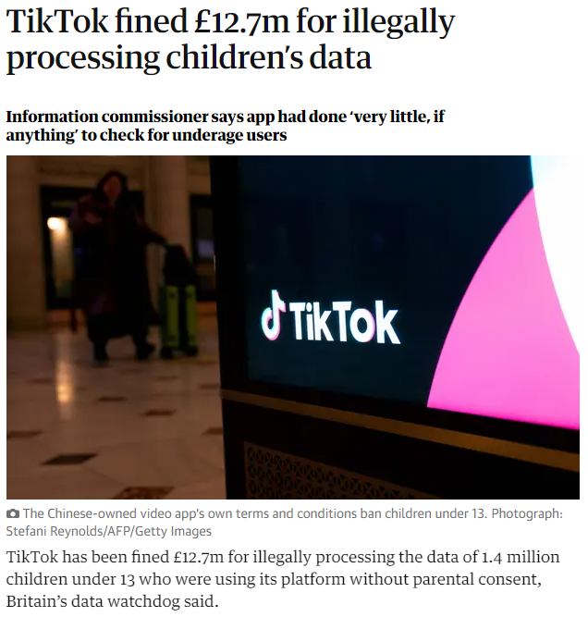
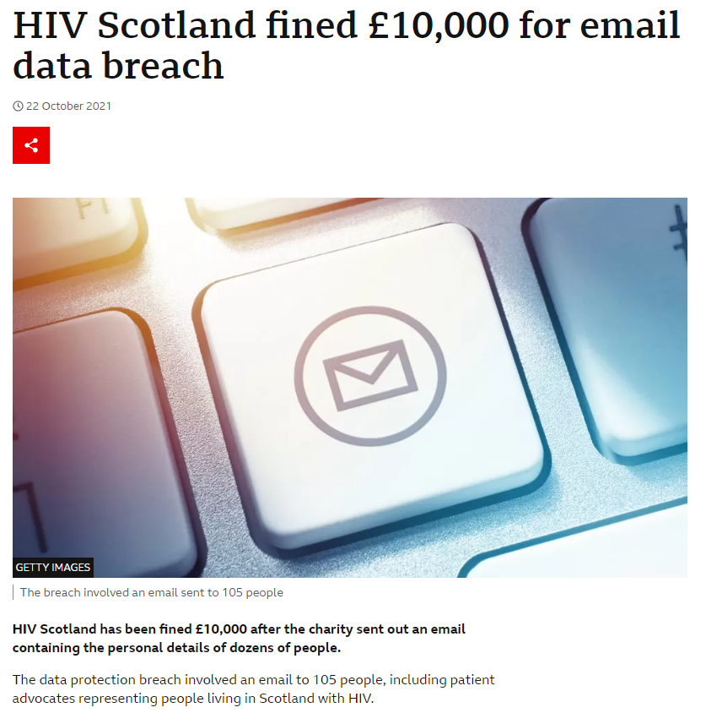
Consequences
13 fines in the UK since 2018
Largest = £13m (TikTok)
Smallest = £10k (HIV Scotland)
Fines VERY unlikely
Online assessment tool
Has a data breach occurred?
Does it involve personal data?
Is there a risk to rights and freedoms?
Report/Record advice

Slide 16
Special Categories
Special category data is personal data which the GDPR says is more sensitive, and so needs more protection
Includes race, ethnic origin, politics, religion, trade union membership, genetics, biometrics (where used for ID purposes), health, sex life, sexual orientation
In order to lawfully process special category data, you need to identify a lawful basis and a separate condition for processing special category data
There are ten conditions for processing special category data in the GDPR so far, similar to DPA.
Can’t cover here, but covered on ICO website.

Slide 17
Other Considerations
Keep an eye on the ICO website
ICO focus will be on those who have made no effort to comply, but why risk it?
GDPR applies to all organisations regardless of size and whether staff run or volunteer run
Your response to GDPR can be proportionate to the size of organisation and level of risk you face
If in doubt, seek consent
If still in doubt, delete!

Slide 18
Test Time!
Contract
After this conference, I will send you all copies of these slides.
What is my lawful basis for processing your data?
What should I include in any communications to you?
What can you do if you do not want to receive messages from me?
After sending you an email about GDPR, can I then send you some emails about charity governance?
After sending an email about charity governance, can I then send you a link to my crowdfunding page?
After sending a few emails about my services, can I then pass on your details to a specialist charity insurance company?
Why I am sending the message
Summary of your rights
Unsubscribe process
Contact details
Can be a link to privacy statement
Yes – legitimate interest
Needs balance check, but probably not without consent
Not without explicit consent

Slide 19
Further Information
Information Commissioner’s Office
The definitive source!
Lots of guidance
Helpline - 0303 123 1113 – be prepared to hold for up to 30 minutes!
NCVO, NAVCA etc
Surrey Community Action

