Slide 1
Collaboration
Contrasting Case Studies…
Kerry Outlaw Interim CEO Kent ACRE
26 Sept 2024

Slide 2
Context
The Organisations
Their Stated Objectives
A global operation covering 59 countries within a large bank
Two independent members of a national charity.
Several different NFP organisations bidding for the same funding pot.
Cultural shifts - to empowering leadership, sharing of knowledge and greater innovation to deliver efficiencies and better quality services.
Keeping both organisations alive financially, harmonising services.
Winning competitive bids for funding: better serving beneficiaries.
X

Slide 3
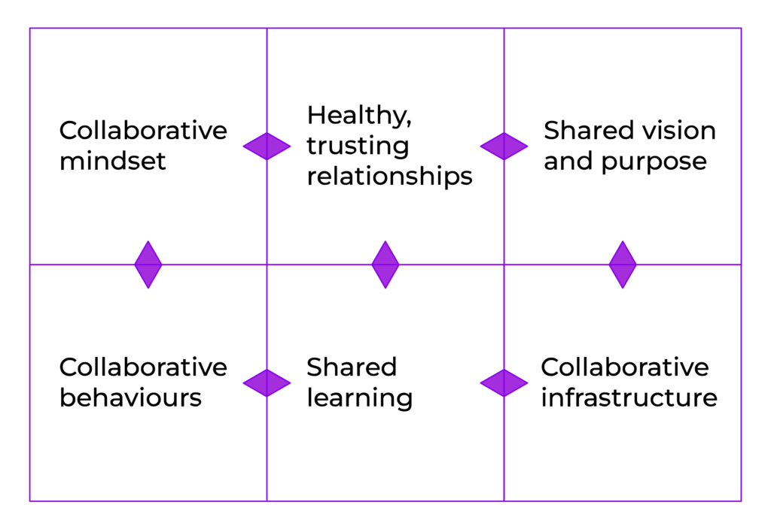
Why Collaborate? The Basic Foundations
Alone we can do so little; together we can do so much." – Helen Keller
If everyone is moving forward together, then success takes care of itself. —Henry Ford
Coming together is a beginning, staying together is progress, and working together is success. —Henry Ford
It is the long history of humankind (and animal kind, too) those who learned to collaborate and improvise most effectively have prevailed. —Charles Darwin
People working together in a strong community with a shared goal and a common purpose can make the impossible possible. –Tom Vilsack

Slide 4
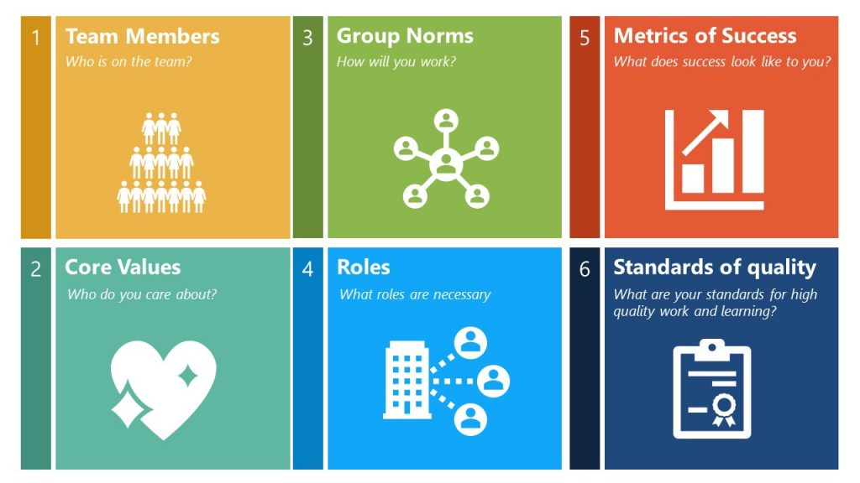
Establishing a shared purpose and vision
“Who do you serve?”
“If these organisations/teams didn’t exist, why would you be created?”
Shared purpose – The WHY
Collaboration Charter
Who, How, What?

Slide 5
The Challenges and the Outcomes
1.
2.
3.
BUT:
Egos of leaders.
Lack of trust amongst leaders.
Overcome by their teams being driven by the “why” and holding their leaders to account!
WHY?
High level purpose and vision undermined by inability to identify and leverage each organisation’s strengths.
Individual’s fear of loss of role undermined roles and group norms.
WHY?
Competition underpinned by grant authority and process. – no expectation of a shared purpose/vision or stakeholder voice.
Competitive organisations and senior level egos.
Lack of trust
Collaboration an afterthought.

Slide 6
Lessons learnt
For collaboration to succeed
There MUST be a shared purpose and vision – an agreed WHY
Recognise and leverage the relative strengths of each party - Look for and agree the “win/wins”
Internal and external stakeholders must be engaged and on board
Leadership must “walk the walk” not just “talk the talk”
Nothing will succeed without trust
There is never room for egos
Make room for learning and to celebrate success

