Slide 1

Welcome
Major donor fundraising -stronger together
Louise Morris
26th September 2024

Slide 2


Collaboration with major donor fundraising is:
Culture
Curiosity
Closest to home

Slide 3

Collaboration with major donor fundraising is:
Culture
Curiosity
Closest to home

Slide 4
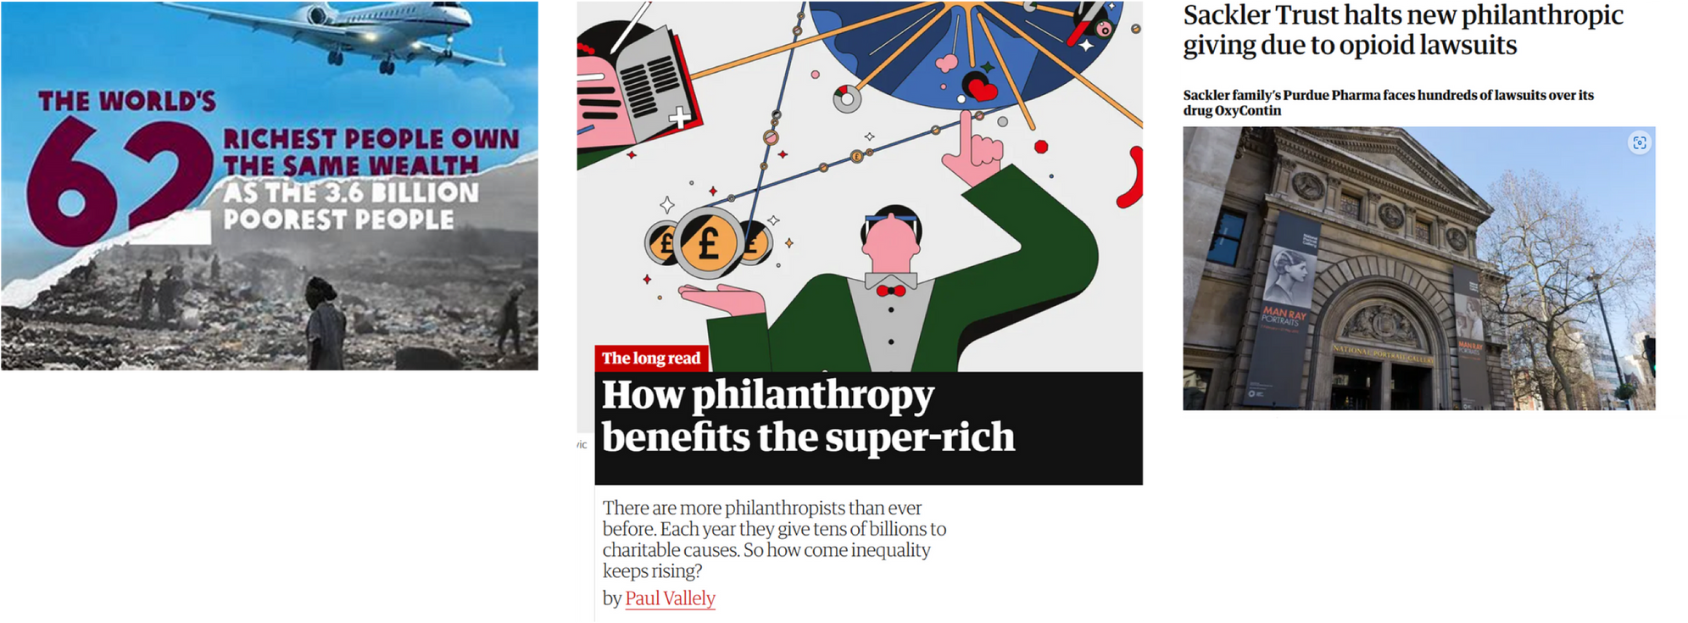
What makes you uncomfortable?

Slide 5

In Defence of Philanthropy

Slide 6
I highly recommend a gift to one of the thousands of organisations doing remarkable work.
Every one of them could benefit from more resources to share with the communities they’re serving.
And the hope you feed your gift with is likely to feed your own.
MacKenzie Scott

Slide 7
When you have a lot of money you can:
  Spend it
  Give it to your children or family
  Give it away to make a difference

Slide 8
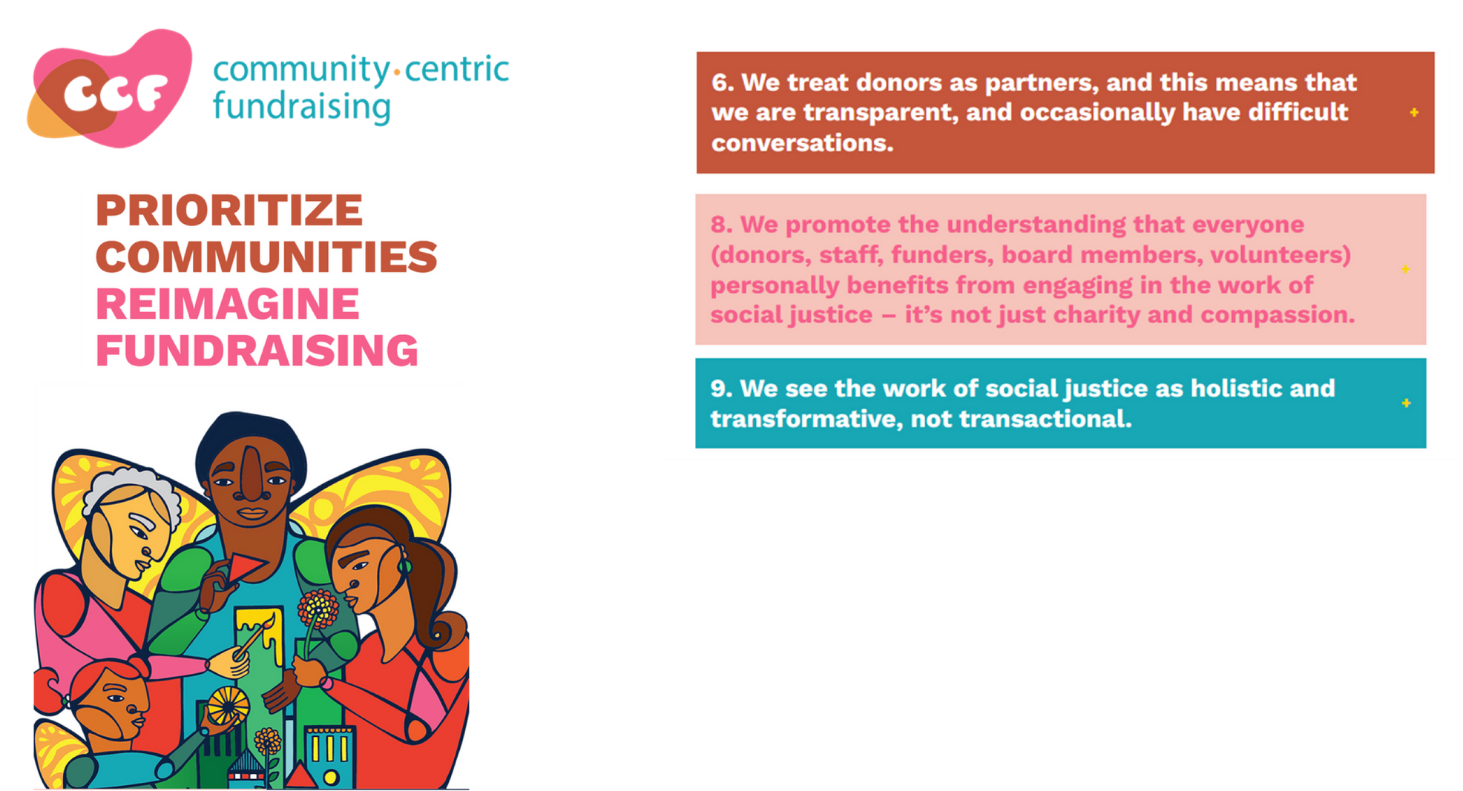

Slide 9
Collaboration with major donor fundraising is:
Culture
Curiosity
Closest to home

Slide 10

Curiosity conversations

Slide 11
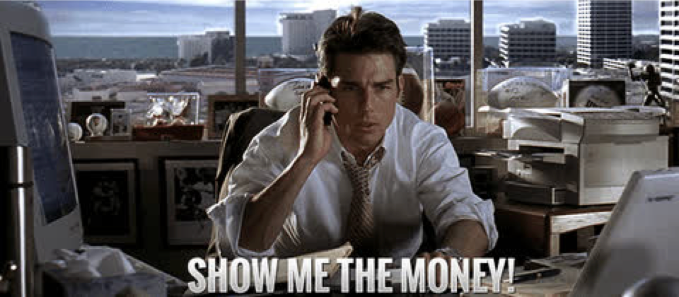
Show me the money...?

Slide 12

Put yourself in your donors shoes
Be curious
  Embrace your natural curiosity
  Ask lots of questions
  Discover the person, not a ‘prospect’

Slide 13
55% of communication relating to feelings or attitudes is non-verbal
Albert Mehrabian, 1967

Slide 14
5 reasons it’s worth it
  Trust
  You can be curious
  Doors open
  You can offer/ask
  Energy!

Slide 15
Collaboration with major donor fundraising is:
Culture
Curiosity
Closet to home

Slide 16

Start off closest to home

Slide 17




Supporter data
Networks
People you think COULD give your cause a larger gift
Creating a long-list of potential major donors

Slide 18
Supporter data
Networks
People you think COULD give your cause a larger gift
Creating a long-list of potential major donors

Slide 19
Supporter data
Networks
People you think COULD give your cause a larger gift
WEALTH RESEARCH
A short list of potential major donors

Slide 20



Slide 21


Who do you know who would want to give a large gift to us?
Who do you think would be inspired by the difference we’re making, and want to find out more?

Slide 22

Task
For two minutes, consider one individual who you think could be a major donor or help with your programme. Write their name down.

Slide 23
Start off closest to home

Slide 24
Collaboration in major donor fundraising:
Culture
Curiosity
Closet to home

Slide 25
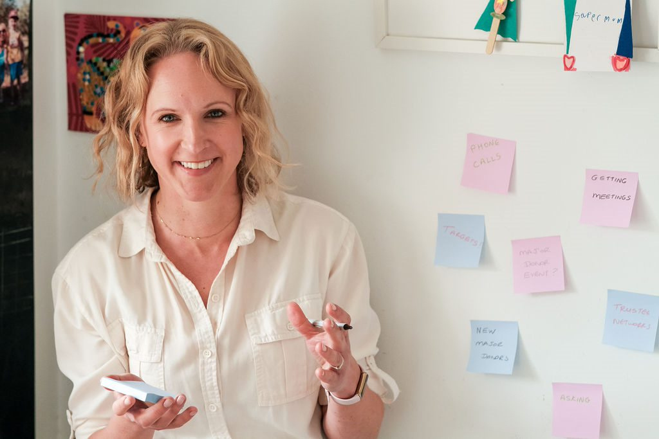
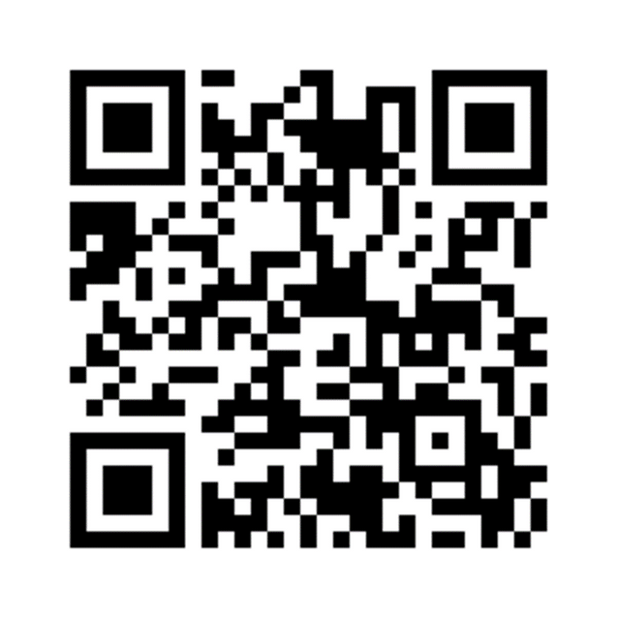
Join the Summit community for free
Louise Morris
www.summitfundraising.co.uk

Slide 26
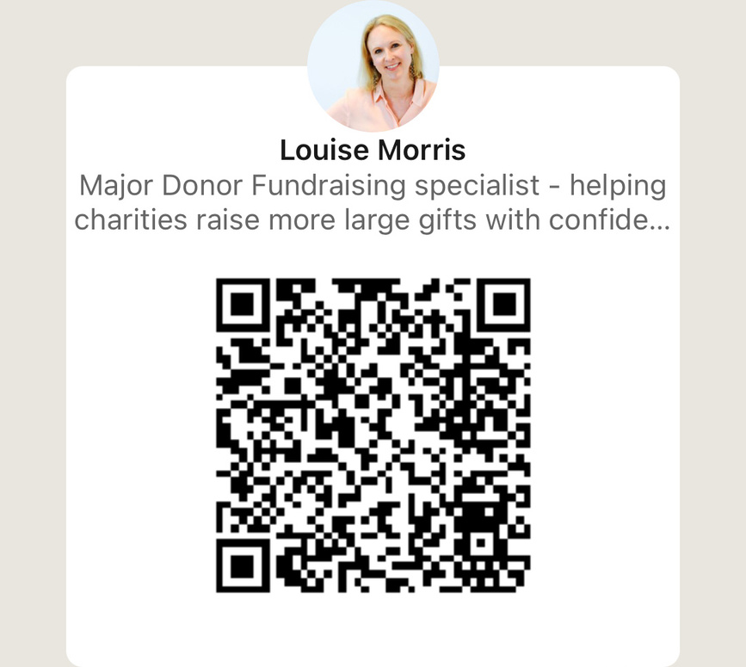
Major donor fundraising you can be proud of
Louise Morris
www.summitfundraising.co.uk

Slide 27

Thank you!
Major donor fundraising -stronger together
Louise Morris

